Slide 1

Chemistry for Whom and for
What Purpose?
Michigan State University
Ryan Stowe
March 19th, 2025
rstowe@chem.wisc.edu
stowe.chem.wisc.edu

Slide 2
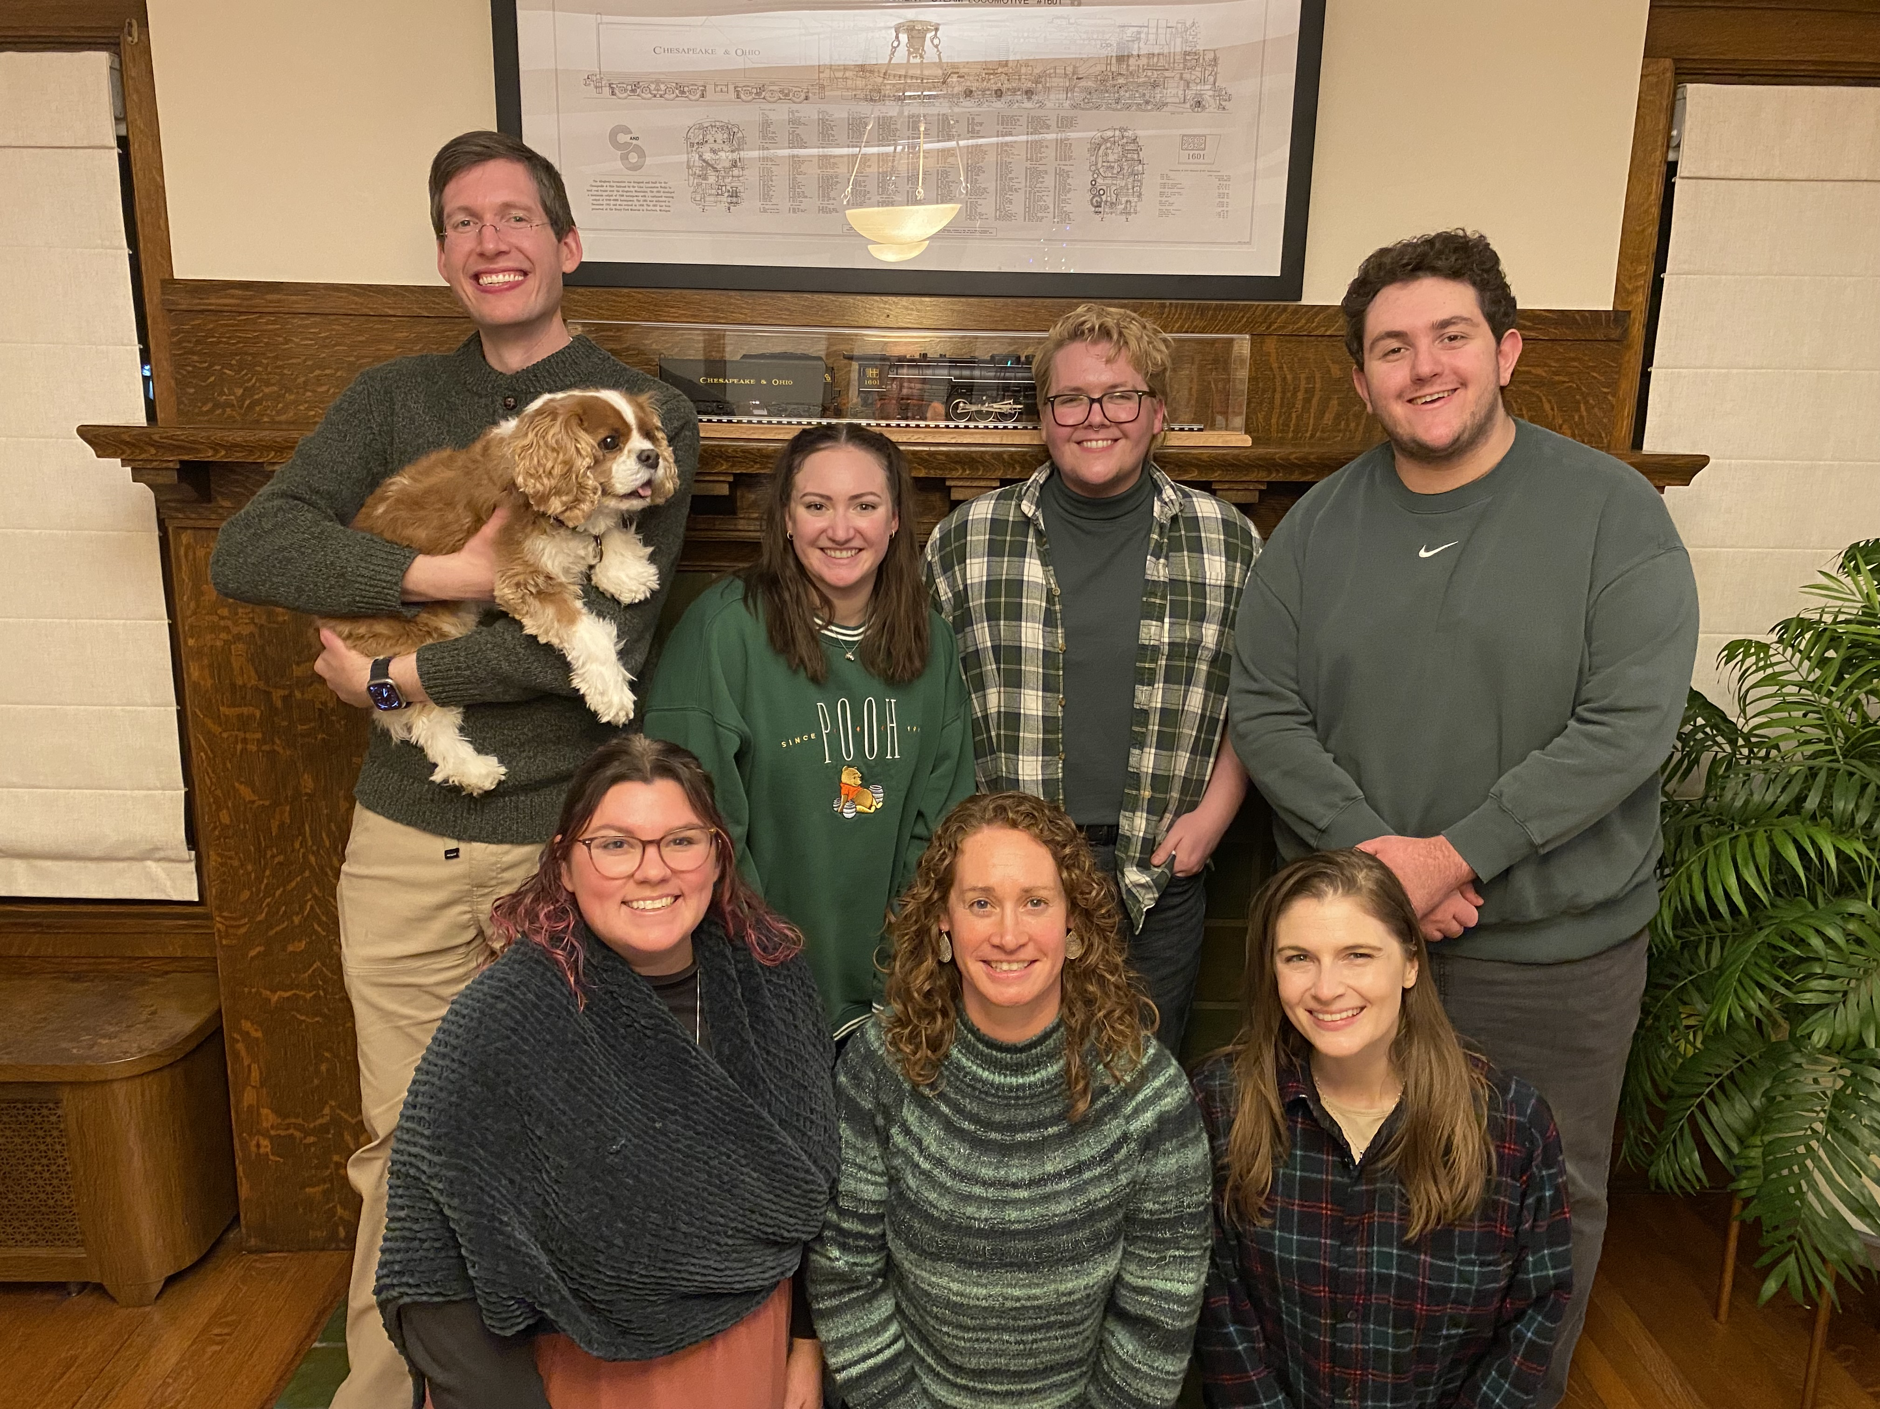


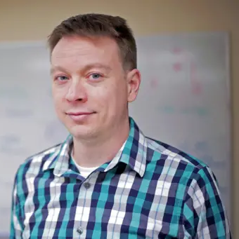


The Team
DUE 2225025
DRL 2003680

Slide 3
Why should students take chemistry classes?
Chemistry knowledge will help them make more informed personal and political choices
Some of them will go on to be chemists
Chemistry is super cool
Chemistry helps students build critical thinking skills that are useful in life

Slide 4
Why should students take chemistry classes?
Chemistry knowledge will help them make more informed personal and political choices
Some of them will go on to be chemists
Chemistry is super cool
Chemistry helps students build critical thinking skills that are useful in life

Slide 5
Why should students take chemistry classes?
Chemistry knowledge and practices are useful in daily life
Useful in daily life: “help people solve personally meaningful problems in their lives, directly affect their material and social circumstances, shape their behavior, and inform their most significant and practical political decisions” (Feinstein, 2011, p 169)
Feinstein, N. (2011). Salvaging science literacy. Science Education, 95(1), 168–185.

Slide 6
This Notion is Not New …
“the ability to use the methods of chemistry in the solution of problems of concern to the individual, the community, the nation and the world [is a central goal of chemistry coursework]”
- (Morris, 1964, p 192)
“… in our democratic society objective thinking based upon an understanding of the structure and interaction of matter leads to a better life and should, therefore, be a part of the education of all”
- (Arnold, 1961, p 445)
Morris, G.C. (1964). The objectives of Australian secondary school courses in chemistry. Australian Journal of Education, 8 (3), 192–208.
Arnold, L.A. (1961). Some phases of research in the development of a general education college chemistry course. Science Education, 45 (5), 377-377.
Notes:
Emphasize here that chemistry is meant for all (or most) citizens and it is meant to help them navigate personally/societally meaningful challenges.

Slide 7
Constructing Knowledge in Daily Life

Slide 8
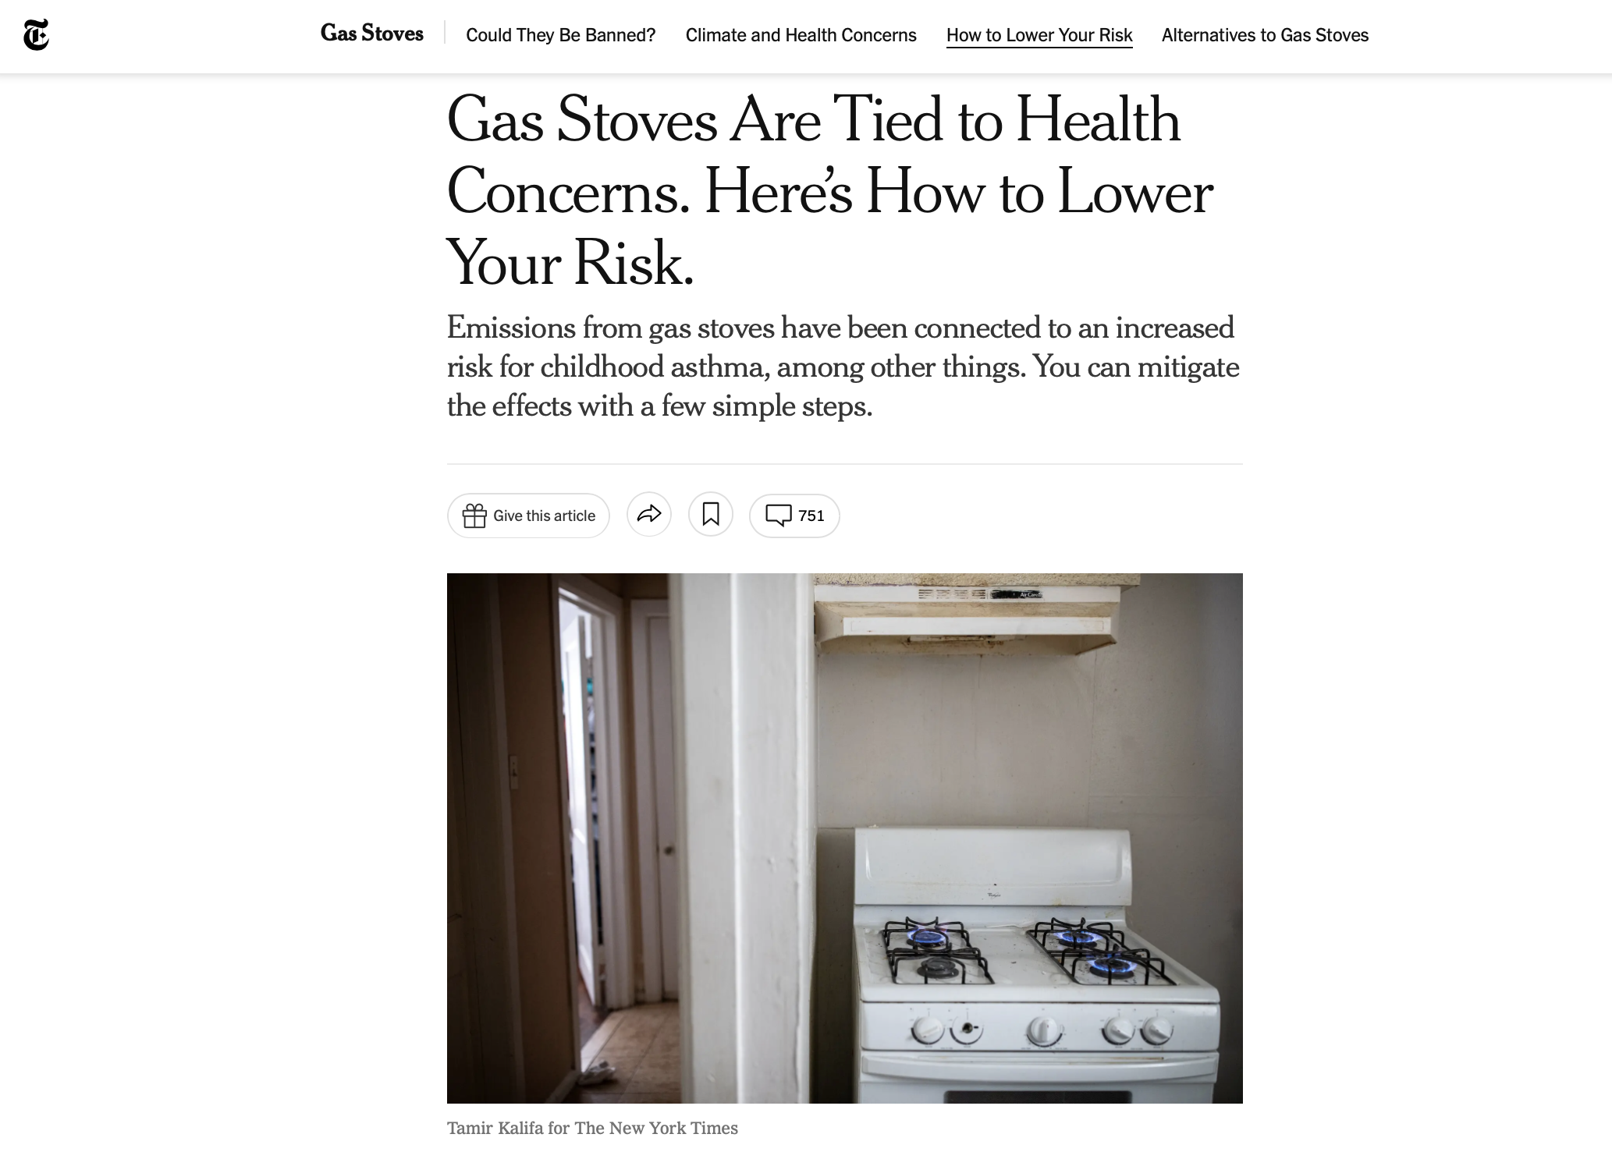
Constructing Knowledge in Daily Life
When you use a gas stove, it emits poisonous gases called nitrogen oxides, including nitrogen dioxide, a respiratory irritant thought to trigger asthma.
Blum, D. (2023, January 14). Gas Stoves Are Tied to Health Concerns. Here’s How to Lower Your Risk. The New York Times. https://www.nytimes.com/2023/01/11/well/live/gas-stoves-health-risks.html

Slide 9
Constructing Knowledge in Daily Life
A study published last year found that families who use gas stoves in homes with poor ventilation, or without range hoods, can blow past the national standards for safe hourly indoor explores to nitrogen oxides within just a few minutes
Blum, D. (2023, January 14). Gas Stoves Are Tied to Health Concerns. Here’s How to Lower Your Risk. The New York Times. https://www.nytimes.com/2023/01/11/well/live/gas-stoves-health-risks.html

Slide 10
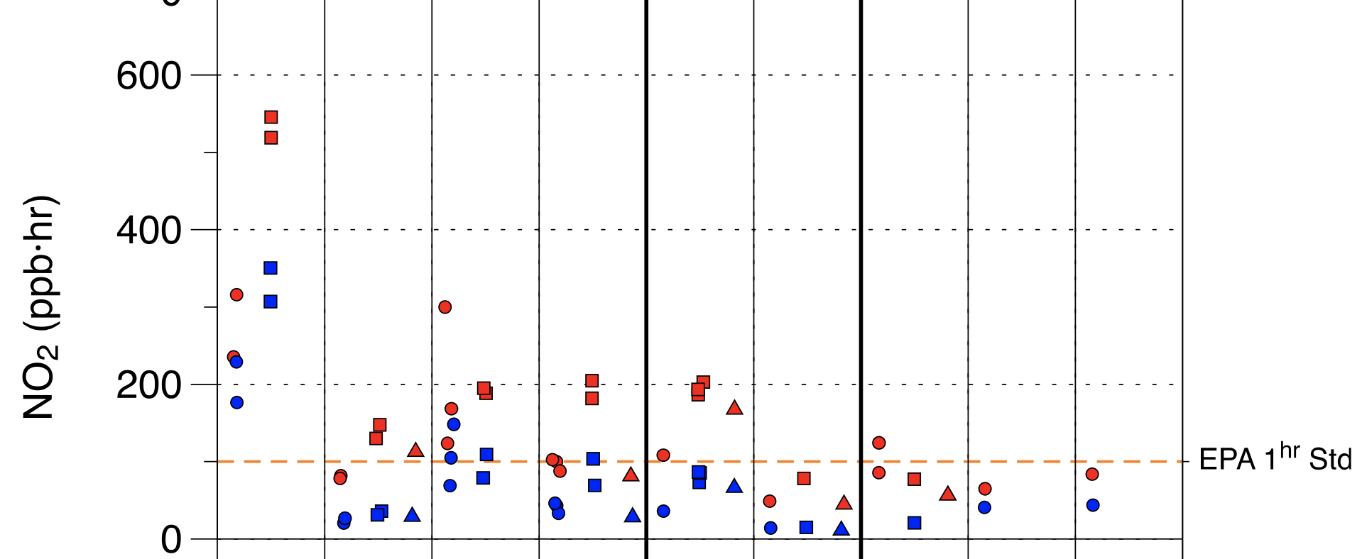
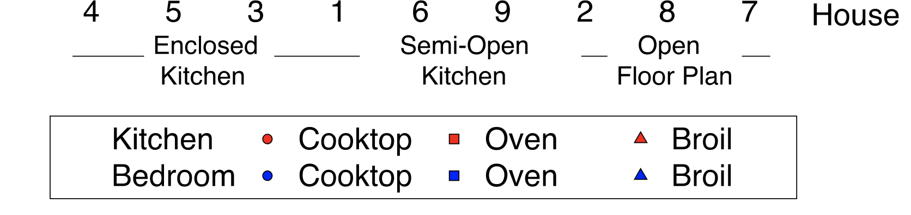
Constructing Knowledge in Daily Life
Singer, B.C., Pass, R.Z., Delp, W.W., Lorenzetti, D.M., & Maddalena, R.L. (2017). Pollutant concentrations and emission rates from natural gas cooking burners without and with range hood exhaust in nine California homes. Building and Environment, 122, 215-229.

Slide 11
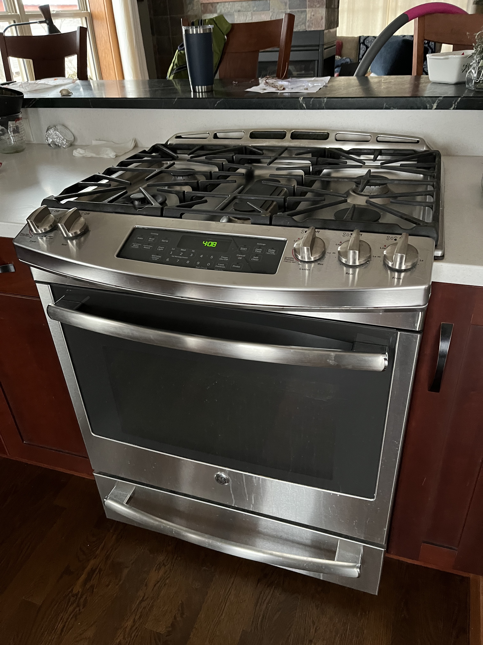
Constructing Knowledge in Daily Life

Slide 12
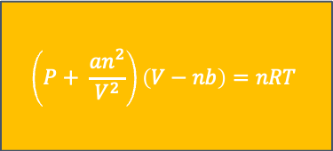
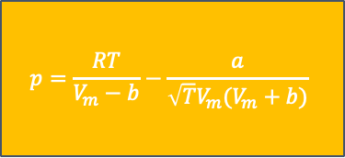
I know a lot about this topic that could be useful!
PV=nRT
NO₂ has pi bonding interactions
Stuff spreads out when it moves into a new area
Gas stoves work by emitting gas molecules via the flames
Should I be worried about my stove?
$$\left(P+ \frac{an^{2}}{V^{2}}\right)\left(V−nb\right)=nRT$$
Molecules interact via elastic collisions
Some gases are good for me and some gases are bad for me.
If stuff has nowhere to go, it will build up in one area
$$p=\frac{RT}{V_{m}−b}−\frac{a}{\sqrt{T}V_{m}(V_{m}+b)}$$
Average KE of a gas depends on temp
Notes:
RR start

Slide 13
I know a lot about this topic that could be useful!
PV=nRT
NO₂ has pi bonding interactions
Stuff spreads out when it moves into a new area
Gas stoves work by emitting gas molecules via the flames
Should I be worried about my stove?
$$\left(P+ \frac{an^{2}}{V^{2}}\right)\left(V−nb\right)=nRT$$
Molecules interact via elastic collisions
Some gases are good for me and some gases are bad for me.
If stuff has nowhere to go, it will build up in one area
$$p=\frac{RT}{V_{m}−b}−\frac{a}{\sqrt{T}V_{m}(V_{m}+b)}$$
Average KE of a gas depends on temp
I need a causal story for how this works.
If I don’t know the answer I can construct one based on things I know.
I have some everyday experiences that can help me.
All my ideas about this topic should fit together coherently.
My answer should make sense to me.
Notes:
RR start

Slide 14
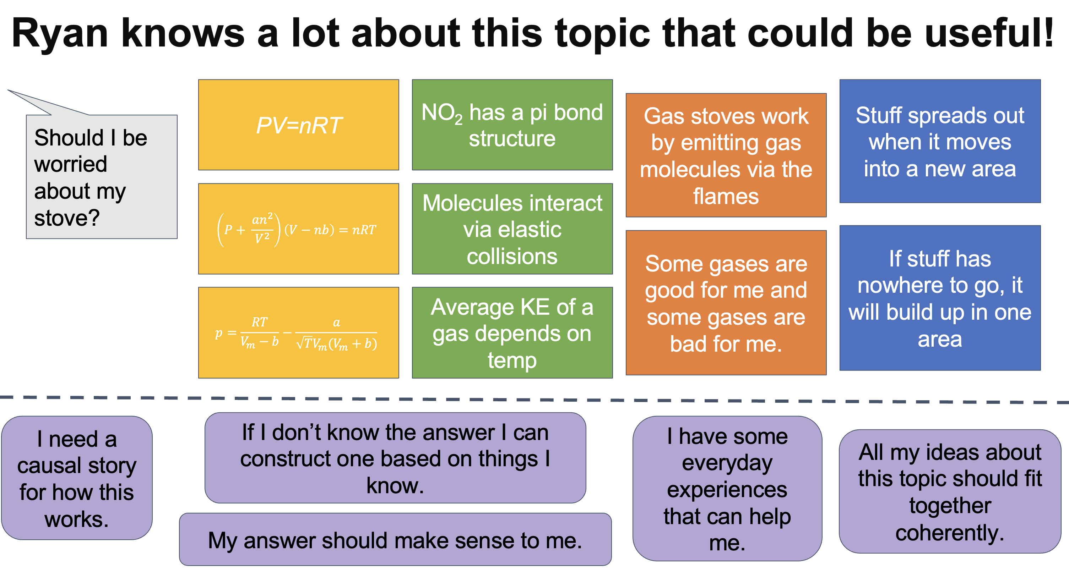
Different kinds of knowledge I have to work with
Conceptual or Content Knowledge:
  Knowledge about the science topic
  Standard focus of chemistry education research (e.g., Holme, Luxford & Brandriet, 2015; Pazicni et al., 2021)
Holme, T.A., Luxford, C.J., & Brandriet, A. (2015) Defining Conceptual Understanding in General Chemistry. Journal of Chemical Education, 92(9), 1477-1483.
Pazicni, S., Wink, D.J., Donovan, A., Conrad, J.A., Darr, J.P., Morgan Theall, R.A., Richter-Egger, D.L., Villata-Cerdas, A., & Walker, D.R. (2021) The American Chemical Society General Chemistry Performance Expectation Project: From Task Force to Distributed Process for Implementing Multidimensional Learning. Journal of Chemical Education, 98(4), 1112-1123.
Notes:
RR start

Slide 15
Different kinds of knowledge I have to work with
Conceptual or Content Knowledge:
  Knowledge about the science topic
  Standard focus of chemistry education research (e.g., Holme, Luxford & Brandriet, 2015; Pazicni et al., 2021)
Meta-Knowledge about Explanation Construction:
  Tacit knowledge about appropriate ways to construct knowledge and appropriate types of knowledge to use
  Referred to as “personal epistemologies” within education research (e.g., Collins & Ferguson, 1993; Hammer, 1994; Hofer & Pintrich, 2002; Sandoval, 2005)
Collins, A., & Ferguson, W. (1993). Epistemic forms and epistemic games: Structures and strategies to guide inquiry. Educational psychologist, 28(1), 25-42.
Hammer, D. (1994). Epistemological beliefs in introductory physics. Cognition and Instruction. 12(2), 151-183.
Hofer, B. K., & Pintrich, P. R. (Eds.). (2002). Personal epistemology: The psychology of beliefs about knowledge and knowing. Lawrence Erlbaum Associates Publishers.
Sandoval, W. A. (2005). Understanding students’ practical epistemologies and their influence on learning through inquiry. Science Education, 89(4), 634–656.
Notes:
RR start

Slide 16
Epistemologies
Epistemologies “consist of [people’s] systems of beliefs [tacit or explicit] about (1) the nature of knowledge and (2) the process of knowing”
- Chinn, Buckland, Samarpungavan, 2011, p. 141
Epistemologies include ideas about aims for knowledge construction, reliable processes for achieving aims, how knowledge is justified etc.
Chinn, C. A., Buckland, L. A., & Samarapungavan, A. L. A. (2011). Expanding the dimensions of epistemic cognition: Arguments from philosophy and psychology. Educational Psychologist, 46(3), 141-167.

Slide 17
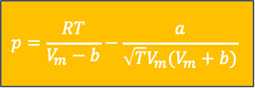
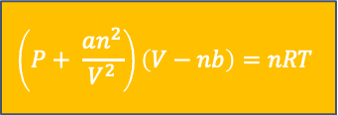
What do epistemologies do?
PV=nRT
NO₂ has pi bonding interactions
Gas stoves work by emitting gas molecules via the flames
Stuff spreads out when it moves into a new area
Should I be worried about my stove?
$$\left(P+ \frac{an^{2}}{V^{2}}\right)\left(V−nb\right)=nRT$$
Molecules interact via elastic collisions
Some gases are good for me and some gases are bad for me.
If stuff has nowhere to go, it will build up in one area
$$p=\frac{RT}{V_{m}−b}−\frac{a}{\sqrt{T}V_{m}(V_{m}+b)}$$
Average KE of a gas depends on temp
Procedural
knowledge
Formal fact like knowledge from school
Everyday
experiential knowledge
Generic schematic knowledge

Slide 18
What do epistemologies do?
PV=nRT
NO₂ has pi bonding interactions
Gas stoves work by emitting gas molecules via the flames
Stuff spreads out when it moves into a new area
Should I be worried about my stove?
$$\left(P+ \frac{an^{2}}{V^{2}}\right)\left(V−nb\right)=nRT$$
Molecules interact via elastic collisions
Some gases are good for me and some gases are bad for me.
If stuff has nowhere to go, it will build up in one area
$$p=\frac{RT}{V_{m}−b}−\frac{a}{\sqrt{T}V_{m}(V_{m}+b)}$$
Average KE of a gas depends on temp
Procedural
knowledge
Formal fact like knowledge from school
Everyday
experiential knowledge
Generic schematic knowledge
My answer should sound science-y.

Slide 19
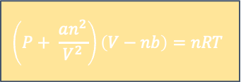
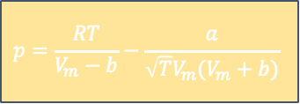
What do epistemologies do?
PV=nRT
NO₂ has pi bonding interactions
Gas stoves work by emitting gas molecules via the flames
Stuff spreads out when it moves into a new area
Should I be worried about my stove?
$$\left(P+ \frac{an^{2}}{V^{2}}\right)\left(V−nb\right)=nRT$$
Molecules interact via elastic collisions
Some gases are good for me and some gases are bad for me.
If stuff has nowhere to go, it will build up in one area
$$p=\frac{RT}{V_{m}−b}−\frac{a}{\sqrt{T}V_{m}(V_{m}+b)}$$
Average KE of a gas depends on temp
Procedural
knowledge
Formal fact like knowledge from school
Everyday
experiential knowledge
Generic schematic knowledge
I need an explanation that makes sense to me.

Slide 20
How and Why I’ve Been Constructing Knowledge
Why Construct Knowledge?
I’d rather not be poisoned by my gas stove
I’d rather not leak a bunch of methane into the atmosphere
How Knowledge Is Being Constructed?
Accumulation from several sources
Knowledge is justified by aligning with data or trusted authorities
Arguments are being crafted related to our options

Slide 21
How and Why I’ve Been Constructing Knowledge
What hasn’t been happening:
No answer key has been consulted
I decided how and why to construct knowledge
My partner and I will decide when we’re “done” engaging in knowledge construction around this issue
Chemistry can help us understand the problem, but not solve it

Slide 22



Reframing Our Goal
Chemistry classes should help learners “explore and discuss the differences between knowledge in multiple contexts” (Elby & Hammer, 2001, p. 564) they will likely encounter in post-school life.
Let’s see how and why students enrolled in a transformed organic chemistry course construct knowledge and consider whether students’ epistemologies are likely to be useful beyond the classroom.
Elby, A., & Hammer, D. (2001). On the substance of a sophisticated epistemology. Science Education. 85(5), 483-614.

Slide 23


How We Understand Epistemology
Beliefs Model
Stable over time
Able to be articulated explicitly
Hierarchical
Multi-dimensional
Network Model
Dynamic over a timescale of minutes
Tacit and inferable from behavior
Have varying utility in different times and places
Multi-dimensional
Rosenberg, S., Hammer, D., & Phelan, J. (2006). Multiple epistemological coherences in an eighth-grade discussion of the rock cycle. The Journal of the Learning Sciences, 15(2), 261-292.
Chinn, C. A., Buckland, L. A., & Samarapungavan, A. L. A. (2011). Expanding the dimensions of epistemic cognition: Arguments from philosophy and psychology. Educational Psychologist, 46(3), 141-167.
Notes:
RR end

Slide 24
Study Context
On-sequence, reformed Organic Chemistry I
3x 50-minute whole-class meetings
1x 50-minute small group discussion
Grades determined by 4 high-stakes exams and 3 quizzes
Schwarz, C. E., DeGlopper, K. S., Greco, N. C., Russ, R. S., & Stowe, R. L. (2025). Modeling student negotiation of assessment-related epistemological messages in a college science course. Science Education, 109(2), 429-447.

Slide 25

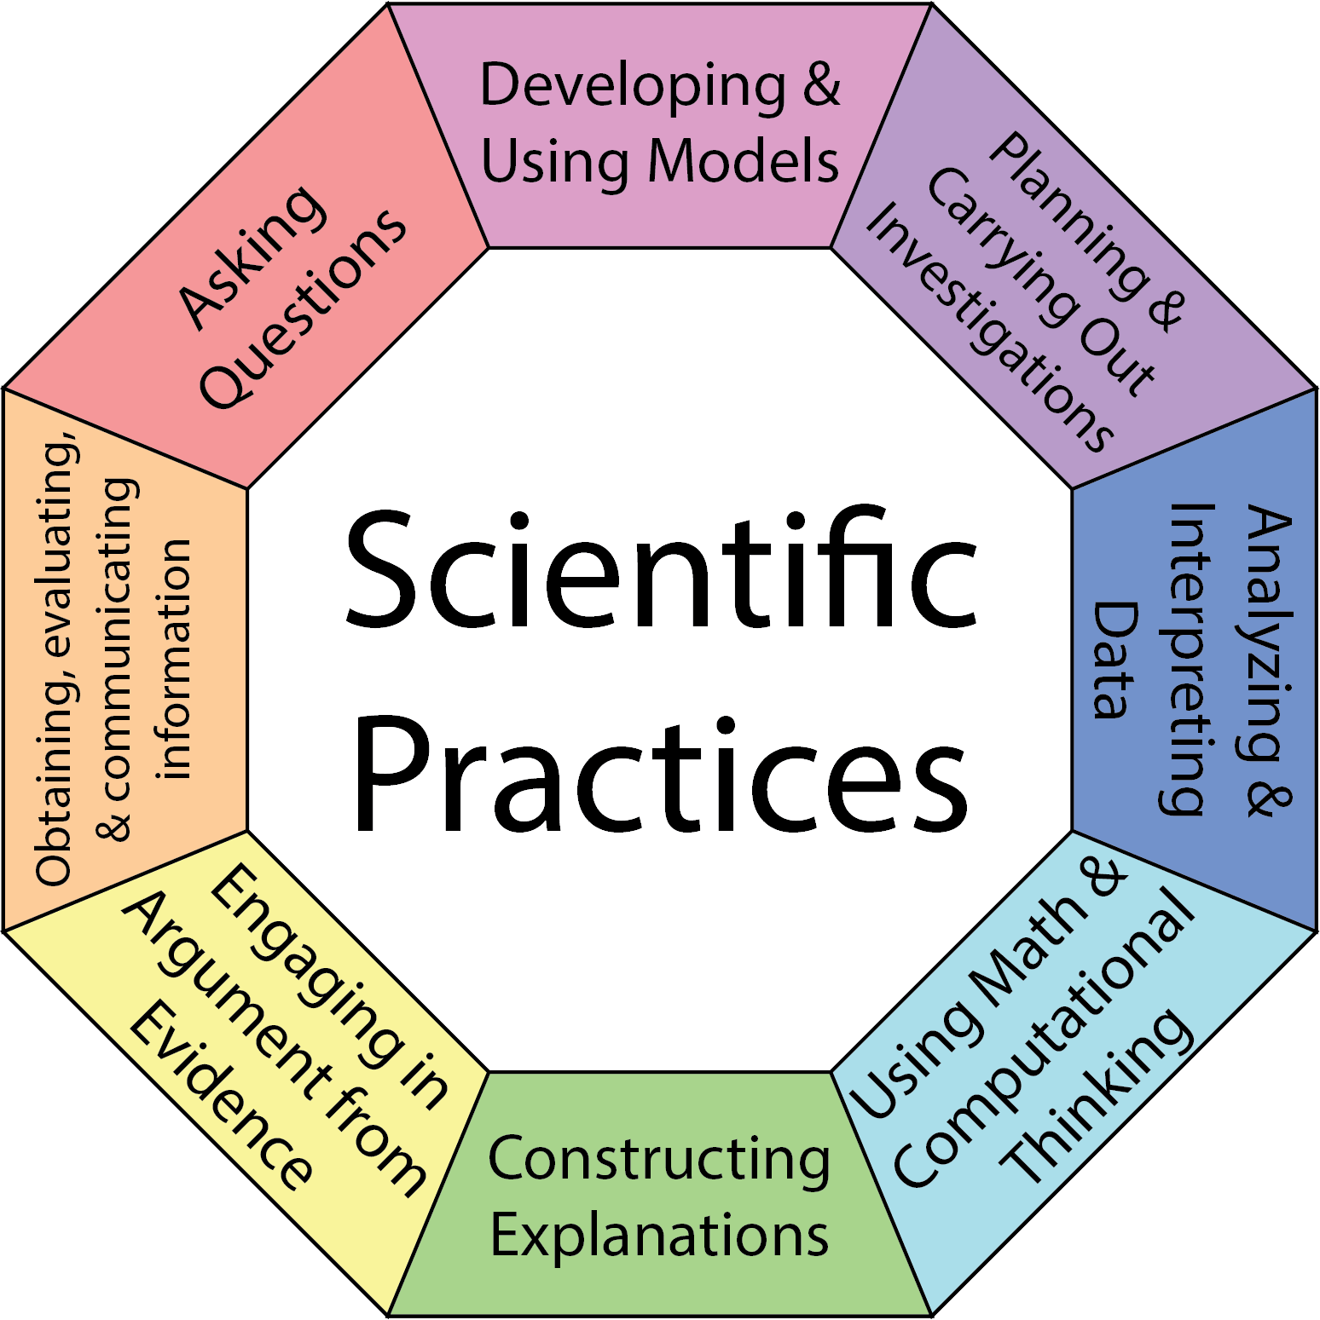
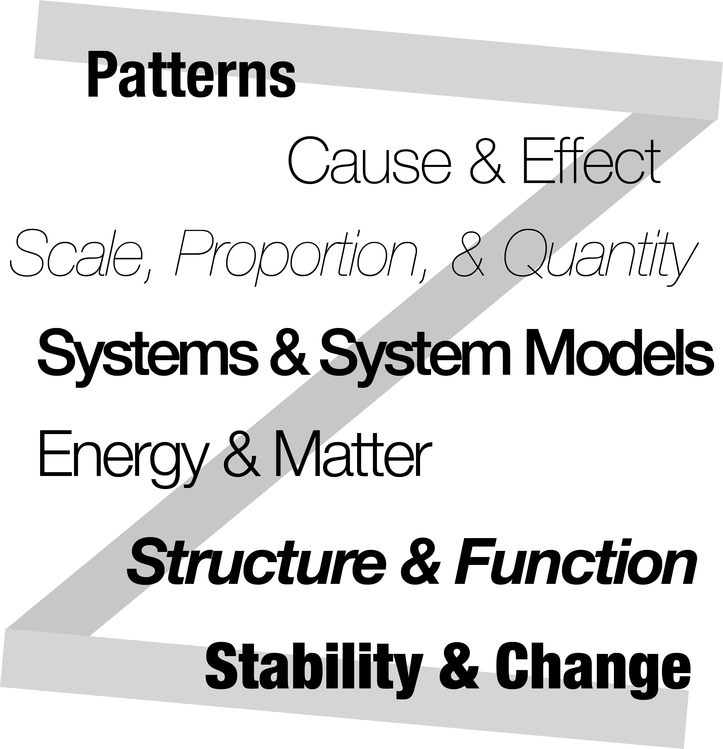
Reform Focus: Supporting 3D Learning
Disciplinary Core Ideas
Scientific Practices
Crosscutting Concepts
What we want students to know
How we want students to construct and apply knowledge
Concepts that bridge disciplines
Notes:
Put something on this slide to start …

Slide 26

Reform Focus: 3-Dimensional Learning
Three-dimensional learning (3DL) explicitly integrates core ideas, crosscutting concepts, & scientific practices
Disciplinary Core Ideas
Scientific Practices
Crosscutting Concepts
What we want students to know
How we want students to construct and apply knowledge
Concepts that bridge disciplines
National Research Council. (2012). A Framework for K-12 Science Education: Practices, Crosscutting Concepts, and Core Ideas. Washington DC: The National Academies Press.
Notes:
Put something on this slide to start …

Slide 27
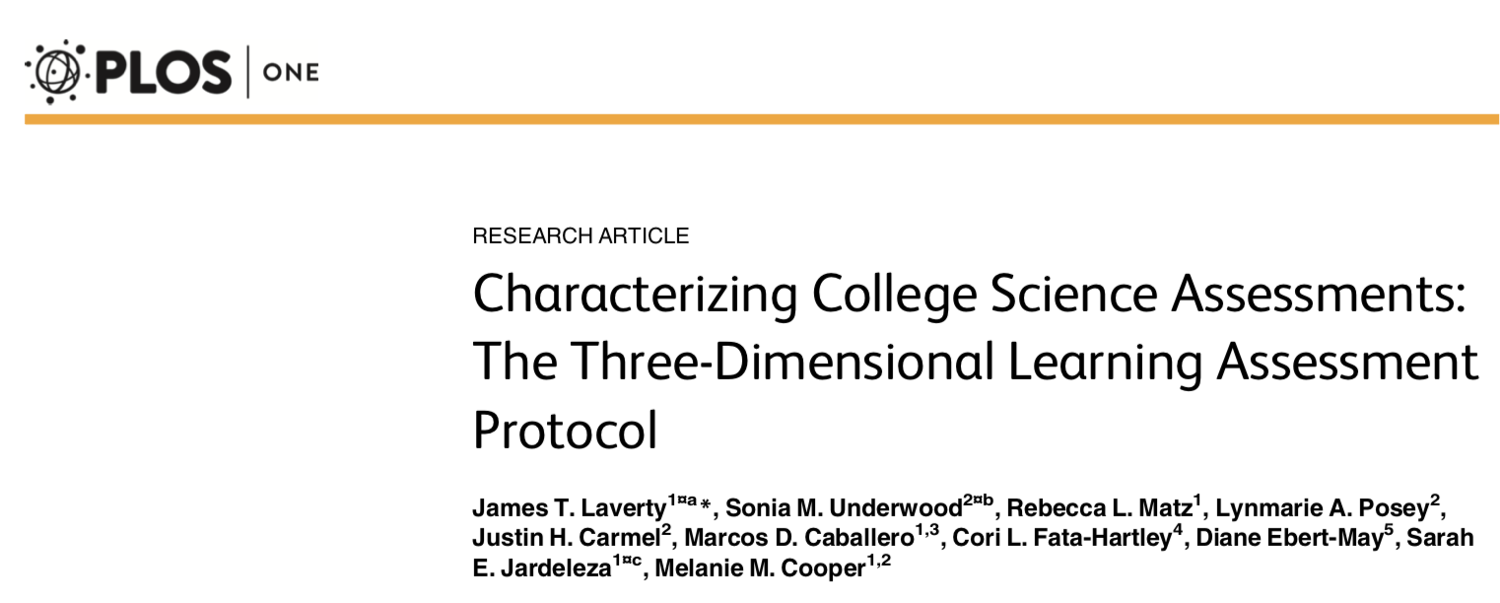
What Was Assessed?

Slide 28
What Was Assessed?
Scientific Practices
Is there a practice? If so, which one(s)?
Laverty, J. T., Underwood, S. M., Matz, R. L., Posey, L. A., Carmel, J. H., Caballero, M. D., Fata-Hartley, C. L., Ebert-May, D., Jardeleza, S. E., & Cooper, M. M. (2016). Characterizing college science assessments: The three-dimensional learning assessment protocol. PLoS One, 11(9), e0162333.

Slide 29
What Was Assessed?
Scientific Practices
Is there a practice? If so, which one(s)?
3D LAP Criteria for “Developing and Using Models”
Give an event, observation, or phenomenon for the student to explain or make a prediction about
Give a representation or ask the student to construct a representation
Ask students to explain or make a prediction about the event, observation, or phenomenon
Ask the student to provide reasoning that links the representation to their explanation or prediction
Laverty, J. T., Underwood, S. M., Matz, R. L., Posey, L. A., Carmel, J. H., Caballero, M. D., Fata-Hartley, C. L., Ebert-May, D., Jardeleza, S. E., & Cooper, M. M. (2016). Characterizing college science assessments: The three-dimensional learning assessment protocol. PLoS One, 11(9), e0162333.

Slide 30
What Was Assessed?
Scientific Practices
Is there a practice? If so, which one(s)?
Core Ideas
Is there a core idea? If so, which one(s)?
Crosscutting Concepts
Is there a crosscutting concept? If so, which ones?
Laverty, J. T., Underwood, S. M., Matz, R. L., Posey, L. A., Carmel, J. H., Caballero, M. D., Fata-Hartley, C. L., Ebert-May, D., Jardeleza, S. E., & Cooper, M. M. (2016). Characterizing college science assessments: The three-dimensional learning assessment protocol. PLoS One, 11(9), e0162333.

Slide 31
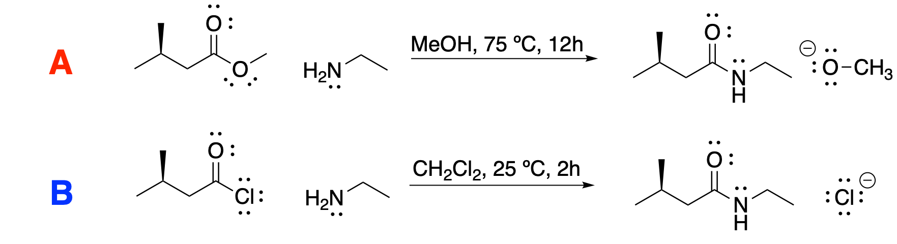
Phenomenon
In search of syntheses for N-ethyl-3-methylbutanamide, you come across the two procedures (labeled A and B below) that both claim to produce good yields of product. You note that procedure A requires both higher temperatures and a longer duration than procedure B.
Energy (kcal/mol)
A potential energy surface showing the change in system energy from reactants to a tetrahedral intermediate is drawn to the right for system B. On the same axis, draw a potential energy surface showing the change in energy along the path from reactants to the tetrahedral intermediate shown for system A.
Reaction Coordinate

Slide 32
Phenomenon
In search of syntheses for N-ethyl-3-methylbutanamide, you come across the two procedures (labeled A and B below) that both claim to produce good yields of product. You note that procedure A requires both higher temperatures and a longer duration than procedure B.
Energy (kcal/mol)
A potential energy surface showing the change in system energy from reactants to a tetrahedral intermediate is drawn to the right for system B. On the same axis, draw a potential energy surface showing the change in energy along the path from reactants to the tetrahedral intermediate shown for system A.
Construct a representation
Reaction Coordinate

Slide 33
Phenomenon
In search of syntheses for N-ethyl-3-methylbutanamide, you come across the two procedures (labeled A and B below) that both claim to produce good yields of product. You note that procedure A requires both higher temperatures and a longer duration than procedure B.
Energy (kcal/mol)
A potential energy surface showing the change in system energy from reactants to a tetrahedral intermediate is drawn to the right for system B. On the same axis, draw a potential energy surface showing the change in energy along the path from reactants to the tetrahedral intermediate shown for system A.
Construct a representation
Reaction Coordinate
Using the potential energy surface you drew above, explain why procedure A requires higher temperature than procedure B to produce product. Make sure to connect the relative energies of reactants to reaction rate.
Explain

Slide 34
Phenomenon
In search of syntheses for N-ethyl-3-methylbutanamide, you come across the two procedures (labeled A and B below) that both claim to produce good yields of product. You note that procedure A requires both higher temperatures and a longer duration than procedure B.
Energy (kcal/mol)
A potential energy surface showing the change in system energy from reactants to a tetrahedral intermediate is drawn to the right for system B. On the same axis, draw a potential energy surface showing the change in energy along the path from reactants to the tetrahedral intermediate shown for system A.
Construct a representation
Reaction Coordinate
Using the potential energy surface you drew above, explain why procedure A requires higher temperature than procedure B to produce product. Make sure to connect the relative energies of reactants to reaction rate.
Explain
Provide reasoning

Slide 35
Emphasis on 3D Tasks
Schwarz, C.E., DeGlopper, K.S., Esselman, B.J., & Stowe, R.L. (2024). Tweaking Instructional Practices Was Not the Answer: How Increasing the Interactivity of a Model-Centered Organic Chemistry Course Affected Student Outcomes. Journal of Chemical Education, 101 (6), 2215-2230.

Slide 36
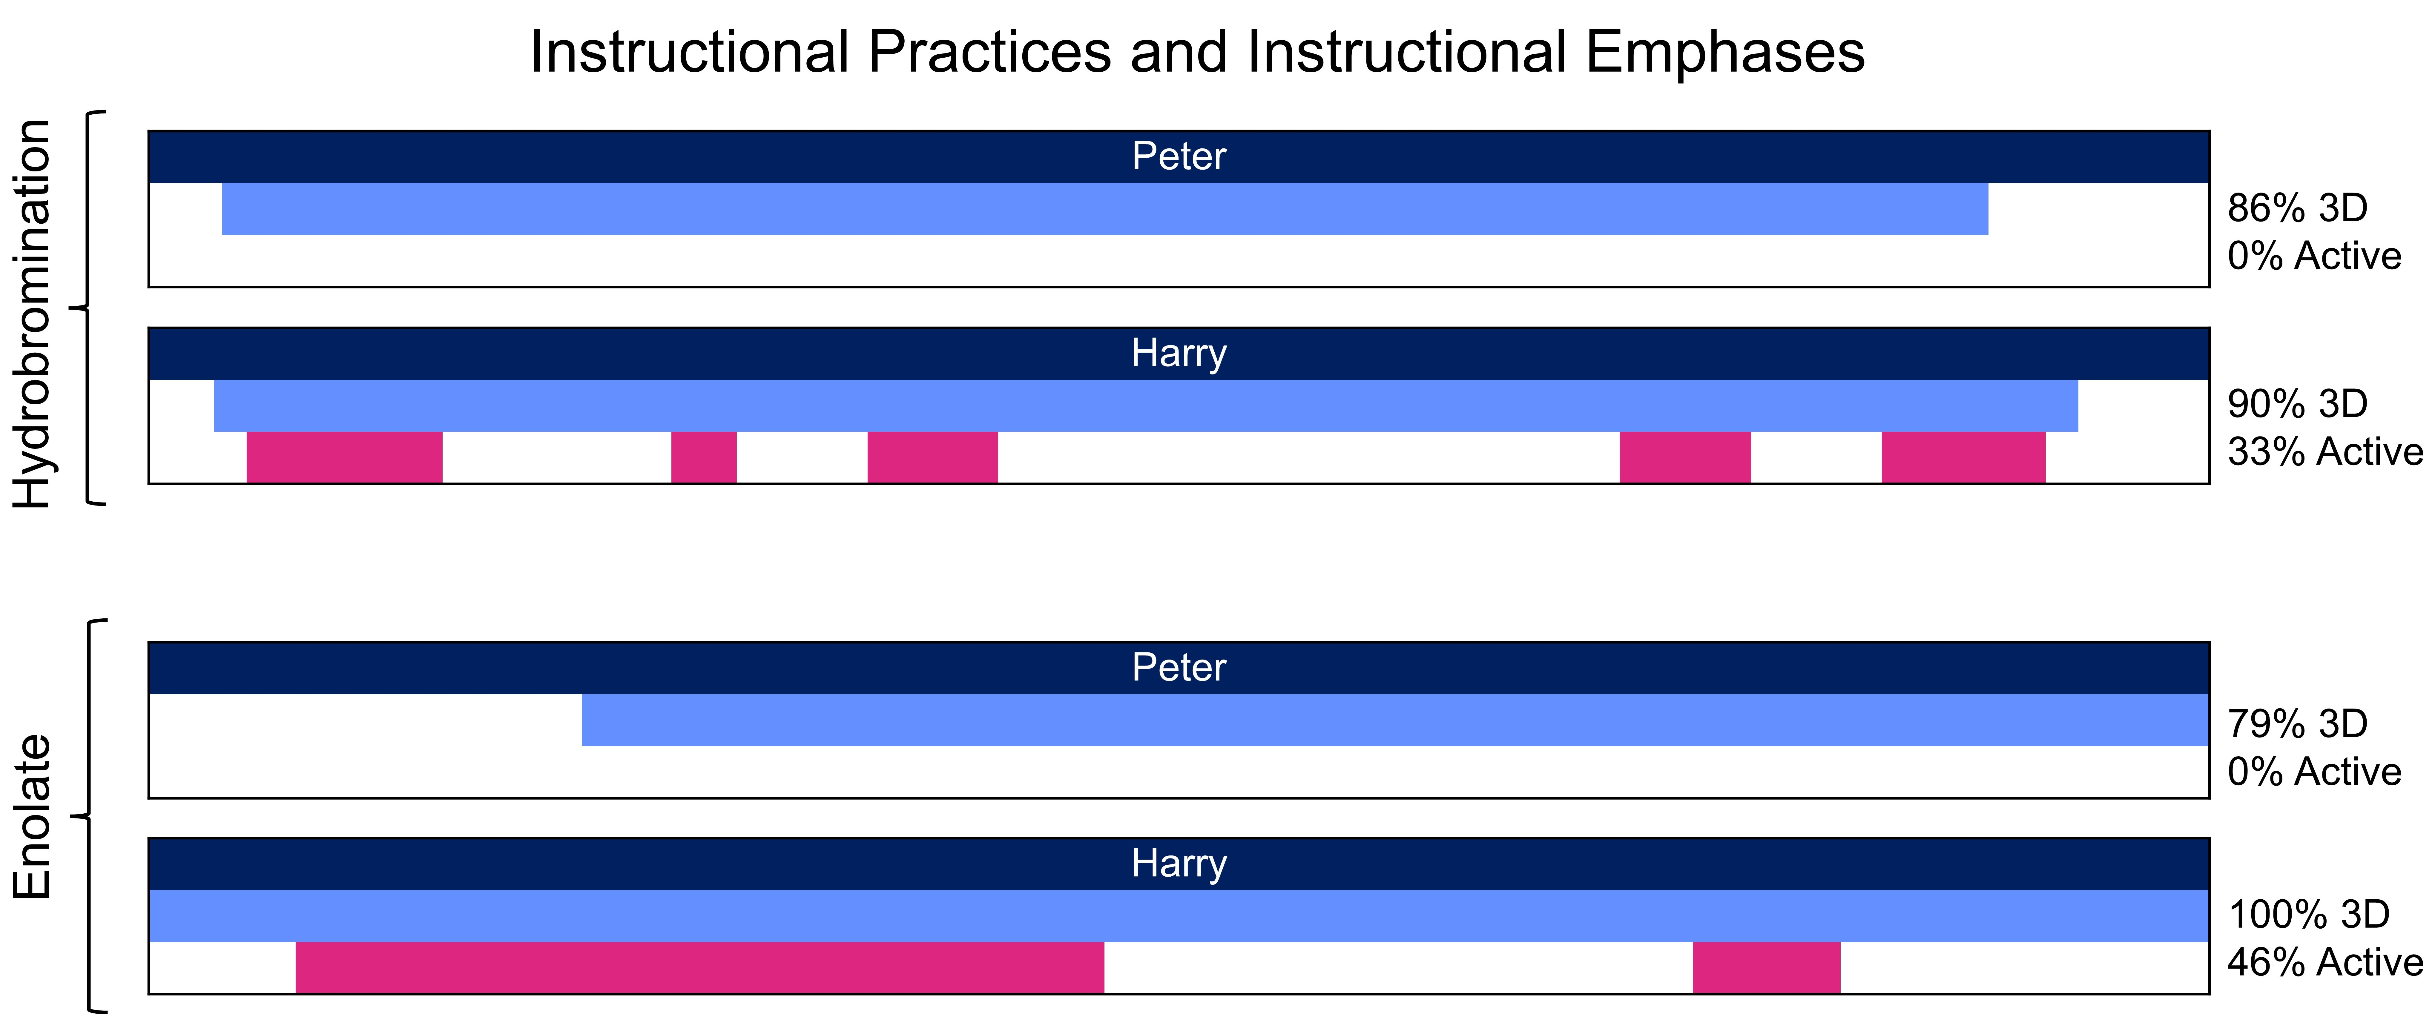
What Instruction Focused On
Hydrobromination
Enolate
69% 3D
Schwarz, C.E., DeGlopper, K.S., Esselman, B.J., & Stowe, R.L. (2024). Tweaking Instructional Practices Was Not the Answer: How Increasing the Interactivity of a Model-Centered Organic Chemistry Course Affected Student Outcomes. Journal of Chemical Education, 101 (6), 2215-2230.
Bain, K., Bender, L., Bergeron, P., Caballero, M. D., Carmel, J. H., Duffy, E. M., Ebert-May, D., Fata-Hartley, C. L., Herrington, D. G., Laverty, J. T., Matz, R. L., Nelson, P. C., Posey, L. A., Stoltzfus, J. R.,Stowe, R. L., Sweeder, R. D., Tessmer, S. H., Underwood, S. M., Urban-Lurain, M., & Cooper, M. M. (2020). Characterizing college science instruction: The three-dimensional learning observation protocol. PLoS One, 15(6), e0234640

Slide 37
How Instruction Happened
Hydrobromination
Enolate
69% 3D
Schwarz, C.E., DeGlopper, K.S., Esselman, B.J., & Stowe, R.L. (2024). Tweaking Instructional Practices Was Not the Answer: How Increasing the Interactivity of a Model-Centered Organic Chemistry Course Affected Student Outcomes. Journal of Chemical Education, 101 (6), 2215-2230.
Smith, M. K., Jones, F. H. M., Gilbert, S. L., & Wieman, C. E. (2013). The classroom observation protocol for undergraduate STEM (COPUS): A new instrument to characterize university STEM classroom practices. CBE—Life Sciences Education, 12(4), 618–627.

Slide 38

Epistemological Messaging Landscape
Epistemological messages embedded in
“The best way for you to prepare for course assessments is to practice explaining how/why chemical phenomena happen on problem sets, during discussion and on practice quizzes/exams”
Instruction
Russ, R. S. (2018). Characterizing teacher attention to student thinking: A role for epistemological messages. Journal of Research in Science Teaching, 55(1), 94-120.
Ke, L., & Schwarz, C. V. (2021). Supporting students' meaningful engagement in scientific modeling through epistemological messages: A case study of contrasting teaching approaches. Journal of Research in Science Teaching, 58(3), 335-365.

Slide 39
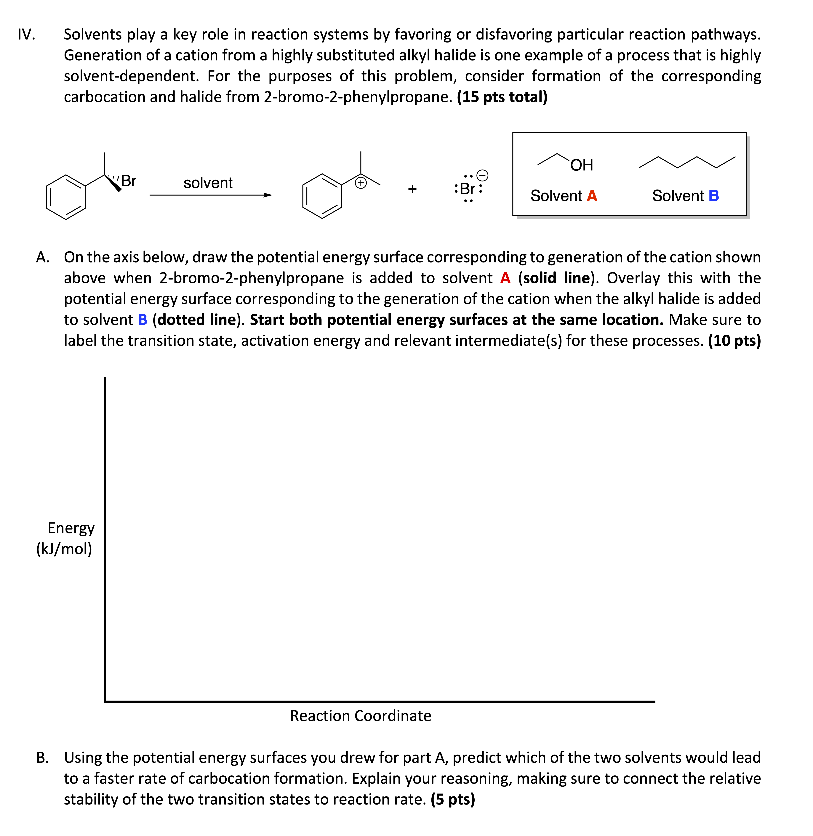

Epistemological Messaging Landscape
Epistemological messages embedded in
Instruction
Assessment
Russ, R. S. (2018). Characterizing teacher attention to student thinking: A role for epistemological messages. Journal of Research in Science Teaching, 55(1), 94-120.
Ke, L., & Schwarz, C. V. (2021). Supporting students' meaningful engagement in scientific modeling through epistemological messages: A case study of contrasting teaching approaches. Journal of Research in Science Teaching, 58(3), 335-365.

Slide 40
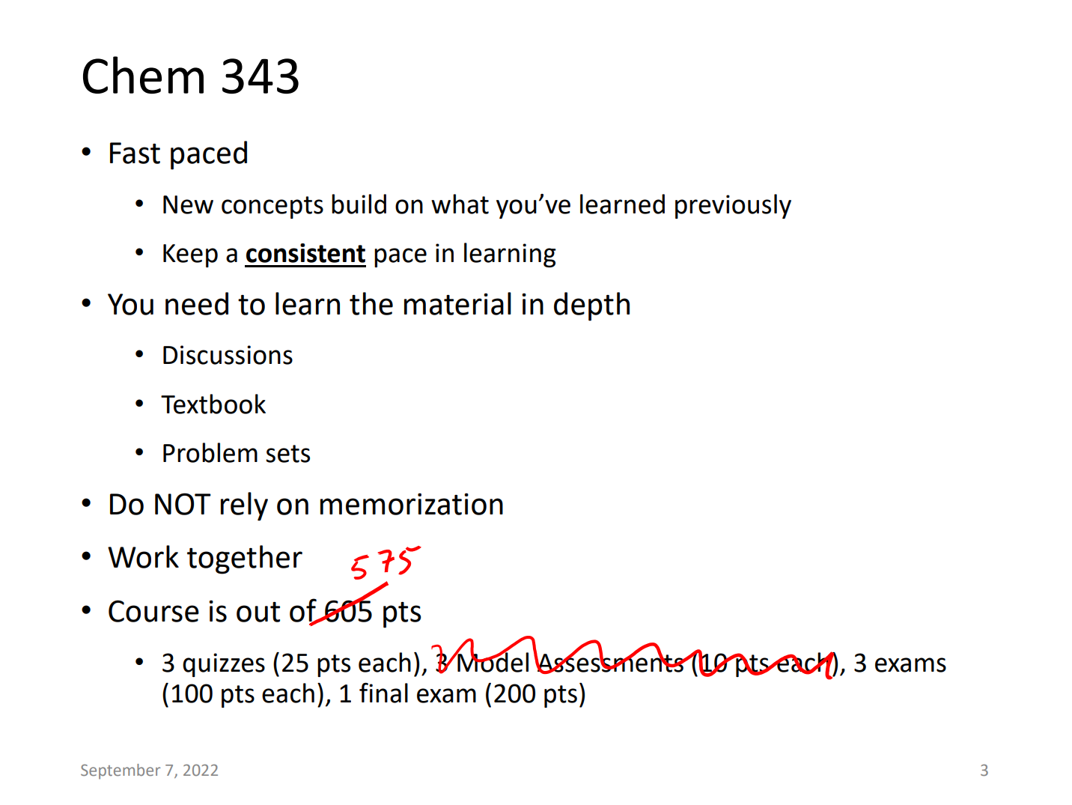

Epistemological Messaging Landscape
Epistemological messages embedded in
[Class]
Instruction
Assessment
Russ, R. S. (2018). Characterizing teacher attention to student thinking: A role for epistemological messages. Journal of Research in Science Teaching, 55(1), 94-120.
Ke, L., & Schwarz, C. V. (2021). Supporting students' meaningful engagement in scientific modeling through epistemological messages: A case study of contrasting teaching approaches. Journal of Research in Science Teaching, 58(3), 335-365.
Curricular materials

Slide 41

Epistemological Messaging Landscape
Epistemological messages embedded in
Inform /
contribute to
Students’ epistemological learning goals
Instruction
Assessment
Mediate
engagement in
Russ, R. S. (2018). Characterizing teacher attention to student thinking: A role for epistemological messages. Journal of Research in Science Teaching, 55(1), 94-120.
Ke, L., & Schwarz, C. V. (2021). Supporting students' meaningful engagement in scientific modeling through epistemological messages: A case study of contrasting teaching approaches. Journal of Research in Science Teaching, 58(3), 335-365.
Curricular materials

Slide 42





Epistemological Messaging Landscape
Epistemological messages embedded in
Inform /
contribute to
Instructors’ (possibly tacit) epistemic learning goals
Students’ epistemological learning goals
Instruction
structure
Assessment
Other types of learning goals, and contextual constraints
Mediate
engagement in
Russ, R. S. (2018). Characterizing teacher attention to student thinking: A role for epistemological messages. Journal of Research in Science Teaching, 55(1), 94-120.
Ke, L., & Schwarz, C. V. (2021). Supporting students' meaningful engagement in scientific modeling through epistemological messages: A case study of contrasting teaching approaches. Journal of Research in Science Teaching, 58(3), 335-365.
Curricular materials

Slide 43
Epistemological Messaging Landscape
Epistemological messages embedded in
Inform /
contribute to
Instructors’ (possibly tacit) epistemic learning goals
Students’ epistemological learning goals
Instruction
structure
Assessment
Other types of learning goals, and contextual constraints
Mediate
engagement in
Russ, R. S. (2018). Characterizing teacher attention to student thinking: A role for epistemological messages. Journal of Research in Science Teaching, 55(1), 94-120.
Ke, L., & Schwarz, C. V. (2021). Supporting students' meaningful engagement in scientific modeling through epistemological messages: A case study of contrasting teaching approaches. Journal of Research in Science Teaching, 58(3), 335-365.
Curricular materials

Slide 44

Research Question
How do assessment-related epistemological messages influence students’ perspectives on valued ways of knowing and learning in a semester-long college STEM course?
Schwarz, C. E., DeGlopper, K. S., Greco, N. C., Russ, R. S., & Stowe, R. L. (2025). Modeling student negotiation of assessment-related epistemological messages in a college science course. Science Education, 109(2), 429-447.

Slide 45
Final
Exam
Exam 1
Exam 2
Exam 3
Schwarz, C. E., DeGlopper, K. S., Greco, N. C., Russ, R. S., & Stowe, R. L. (2025). Modeling student negotiation of assessment-related epistemological messages in a college science course. Science Education, 109(2), 429-447.

Slide 46
Final
Exam
Exam 1
Exam 2
Exam 3
Epistemological Expectations
What does success look like for you? What do you think it takes to succeed in [class]?
Where will you get the knowledge and skills to succeed?
How do you plan to approach studying for assessments?
Based on what you read and what was shown on this lecture slide [show slide], what strategies do you think the instructors would suggest for doing well on assessments in [class]?
Schwarz, C. E., DeGlopper, K. S., Greco, N. C., Russ, R. S., & Stowe, R. L. (2025). Modeling student negotiation of assessment-related epistemological messages in a college science course. Science Education, 109(2), 429-447.

Slide 47
Final
Exam
Exam 1
Exam 2
Exam 3
Assessment-Embedded Epistemological Messages
In a course forum post, [instructor] said that you should focus on factors that stabilize key intermediates and transition states and be able to tell a story about each reaction while drawing its mechanism and potential energy surface [show post]. Is that consistent with your experience? What other strategies have you used to get ready for tests?
Here are three potential answers to the exam question.
  What ideas do you see each person using?
  Where do you think they got these ideas?
  Do you think these responses provide convincing evidence that the person understood what the instructor was intending to assess?
Schwarz, C. E., DeGlopper, K. S., Greco, N. C., Russ, R. S., & Stowe, R. L. (2025). Modeling student negotiation of assessment-related epistemological messages in a college science course. Science Education, 109(2), 429-447.

Slide 48
Final
Exam
Exam 1
Exam 2
Exam 3
Retrospective Interview
In our first interview, you predicted that [fill this in] would be useful places to get knowledge and skills for [class]. Now that you’ve almost finished the course, have your thoughts on your initial prediction changed at all? If so, what has changed? How/why?
In the first interview, you shared your thoughts about why [class] instructors give exams. After what you’ve experienced and learned this semester, do you think exams are a good way to measure understanding of organic chemistry?
What pieces of knowledge or skills seemed most valued in class [based on your experiences in lecture, discussion, with the assessments/how they were graded]?
Schwarz, C. E., DeGlopper, K. S., Greco, N. C., Russ, R. S., & Stowe, R. L. (2025). Modeling student negotiation of assessment-related epistemological messages in a college science course. Science Education, 109(2), 429-447.

Slide 49
Data Analysis Workflow
Data Reduction
Researchers who interviewed each student described the evolution of students’ epistemologies over the three interviews
Selected focal students who were representative of several interviewed students or who expressed an especially rich array of epistemologies

Slide 50
Meet Lexi, Sarah, and Ella
Lexi
Neurobio. Major
Premed
Enrolled in organic to satisfy a prereq.
Ella
Chemistry Major
Aims to attend pharmacy school
Sarah
Chemistry Major
Aims to attend grad. school

Slide 51
Data Analysis Workflow
Data Reduction
Identify and Describe Epistemological Messaging Segments
Transcript segments were selected for further analysis if they:
Related to students’ experience with knowing and learning in the course
Suggested source(s) where the message originated from
Analytic memos for each segment described the focus and source of epistemological messages students experienced as well as how students responded to these messages.

Slide 52
Data Analysis Workflow
Data Reduction
Identify and Describe Epistemological Messaging Segments
When reviewing a “student answer”
Okay, yeah. I like remember that wording [from the answer key]. I looked at it so many times 'cause I tried like remembering the wording they wanted for the exams. So like I literally remember them talking about like the activation energy and the faster rate, which is why I thought that one was the best one.

Slide 53
Data Analysis Workflow
Data Reduction
Identify and Describe Epistemological Messaging Segments
When reviewing a “student answer”
Okay, yeah. I like remember that wording [from the answer key]. I looked at it so many times 'cause I tried like remembering the wording they wanted for the exams. So like I literally remember them talking about like the activation energy and the faster rate, which is why I thought that one was the best one.

Slide 54
Data Analysis Workflow
Data Reduction
Identify and Describe Epistemological Messaging Segments
When reviewing a “student answer”
Okay, yeah. I like remember that wording [from the answer key]. I looked at it so many times 'cause I tried like remembering the wording they wanted for the exams. So like I literally remember them talking about like the activation energy and the faster rate, which is why I thought that one was the best one.

Slide 55
Data Analysis Workflow
Data Reduction
Identify and Describe Epistemological Messaging Segments
Identify Patterns Across Summaries of Epistemological Messaging
Aims, and criteria by which aims are achieved, were homogenized
Reliable processes were compiled differently

Slide 56
Data Analysis Workflow
Data Reduction
Identify and Describe Epistemological Messaging Segments
Identify Patterns Across Summaries of Epistemological Messaging
Aims, and criteria by which aims are achieved, were homogenized
Reliable processes were compiled differently

Slide 57
Findings
Students’ experiences with assessment-related epistemological messages across a semester

Slide 58
Final
Exam
Exam 1
Exam 2
Exam 3
Students Expect to “Do the Lesson”
Schwarz, C. E., DeGlopper, K. S., Greco, N. C., Russ, R. S., & Stowe, R. L. (2025). Modeling student negotiation of assessment-related epistemological messages in a college science course. Science Education, 109(2), 429-447.

Slide 59
Final
Exam
Exam 1
Exam 2
Exam 3
Students Expect to “Do the Lesson”
I do wanna try, at least a little bit, to understand whatever my professors are telling me about and whatever the TAs try to tell us about.
Schwarz, C. E., DeGlopper, K. S., Greco, N. C., Russ, R. S., & Stowe, R. L. (2025). Modeling student negotiation of assessment-related epistemological messages in a college science course. Science Education, 109(2), 429-447.

Slide 60
Final
Exam
Exam 1
Exam 2
Exam 3
Students Expect to “Do the Lesson”
I do wanna try, at least a little bit, to understand whatever my professors are telling me about and whatever the TAs try to tell us about.
Course assessments exist to:
prove that you, you know, actually learn something instead of get quote unquote free credit.
– Ella
Schwarz, C. E., DeGlopper, K. S., Greco, N. C., Russ, R. S., & Stowe, R. L. (2025). Modeling student negotiation of assessment-related epistemological messages in a college science course. Science Education, 109(2), 429-447.

Slide 61
Final
Exam
Exam 1
Exam 2
Exam 3
Students Expect to “Do the Lesson”
What sorts of things need to be learned?
and our lecturer has been giving us buzzwords that we could answer questions with, that kind of means that we’re gonna be having explaining questions.
– Sarah
Schwarz, C. E., DeGlopper, K. S., Greco, N. C., Russ, R. S., & Stowe, R. L. (2025). Modeling student negotiation of assessment-related epistemological messages in a college science course. Science Education, 109(2), 429-447.

Slide 62
Final
Exam
Exam 1
Exam 2
Exam 3
Students’ Aims and Ideals Calcified
When responding to a forum post discouraging use of everyday language:
Schwarz, C. E., DeGlopper, K. S., Greco, N. C., Russ, R. S., & Stowe, R. L. (2025). Modeling student negotiation of assessment-related epistemological messages in a college science course. Science Education, 109(2), 429-447.

Slide 63
Final
Exam
Exam 1
Exam 2
Exam 3
Students’ Aims and Ideals Calcified
When responding to a forum post discouraging use of everyday language:
I think explaining how electrons are donated in a, like a real scientific explanation is important [for the class/exam]. But using words like “attack” or “want” is okay if you’re explaining it to yourself or maybe to other people in a less academic way, like group study maybe.
– Ella
Schwarz, C. E., DeGlopper, K. S., Greco, N. C., Russ, R. S., & Stowe, R. L. (2025). Modeling student negotiation of assessment-related epistemological messages in a college science course. Science Education, 109(2), 429-447.

Slide 64
Final
Exam
Exam 1
Exam 2
Exam 3
Students’ Aims and Ideals Calcified
When considering whether she could solve a new problem:
I think I could probably look at this maybe a little bit and, and try and formulate an answer that makes sense chemically, but isn't probably what they're looking for. – Ella
Schwarz, C. E., DeGlopper, K. S., Greco, N. C., Russ, R. S., & Stowe, R. L. (2025). Modeling student negotiation of assessment-related epistemological messages in a college science course. Science Education, 109(2), 429-447.

Slide 65
Final
Exam
Exam 1
Exam 2
Exam 3
Students’ Aims and Ideals Calcified
What are “they” looking for?
I remember there was one, er, 'cause in like a certain type of problem, like it would ask about stability, and they really wanted you to say "hyperconjugation" 'cause like in all the keys it was like, "hyperconjugation,”
Schwarz, C. E., DeGlopper, K. S., Greco, N. C., Russ, R. S., & Stowe, R. L. (2025). Modeling student negotiation of assessment-related epistemological messages in a college science course. Science Education, 109(2), 429-447.

Slide 66
Final
Exam
Exam 1
Exam 2
Exam 3
Students’ Aims and Ideals Calcified
What are “they” looking for?
I remember there was one, er, 'cause in like a certain type of problem, like it would ask about stability, and they really wanted you to say "hyperconjugation" 'cause like in all the keys it was like, "hyperconjugation,” … on the exam, I literally saw a question that was asking about it. So I just wrote "hyperconjugation" like the first thing, like when I did it, so I would know to say it. And then I got that question right for the answer. 'Cause they wanted that word, I think. – Lexi

Slide 67
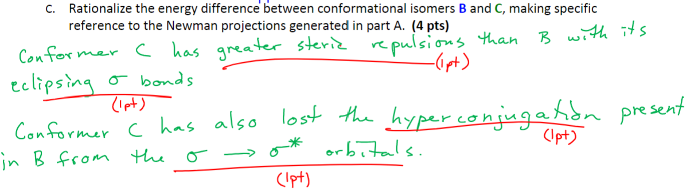
Final
Exam
Exam 1
Exam 2
Exam 3
Students’ Aims and Ideals Calcified
What are “they” looking for?
Schwarz, C. E., DeGlopper, K. S., Greco, N. C., Russ, R. S., & Stowe, R. L. (2025). Modeling student negotiation of assessment-related epistemological messages in a college science course. Science Education, 109(2), 429-447.

Slide 68
Final
Exam
Exam 1
Exam 2
Exam 3
Aims and Ideals Consistent Across Interviews 2 & 3
Authorized knowledge must have a very particular structure:
Schwarz, C. E., DeGlopper, K. S., Greco, N. C., Russ, R. S., & Stowe, R. L. (2025). Modeling student negotiation of assessment-related epistemological messages in a college science course. Science Education, 109(2), 429-447.

Slide 69
Final
Exam
Exam 1
Exam 2
Exam 3
Aims and Ideals Consistent Across Interviews 2 & 3
Authorized knowledge must have a very particular structure:
Sometimes when you draw the products, I drew different wedge and dashes in different spots. And it was sometimes confusing to know if my answer was right too, if it didn't match the keys.
– Lexi
Schwarz, C. E., DeGlopper, K. S., Greco, N. C., Russ, R. S., & Stowe, R. L. (2025). Modeling student negotiation of assessment-related epistemological messages in a college science course. Science Education, 109(2), 429-447.

Slide 70
Final
Exam
Exam 1
Exam 2
Exam 3
Aims and Ideals Consistent Across Interviews 2 & 3
Authorized knowledge must have a very particular structure:
One problem that I had was I would know what happens and I would know why, but I would leave out a keyword or like one out of three factors in the short answer and lose a lot of points from that, which is a little bit frustrating.
– Sarah
Schwarz, C. E., DeGlopper, K. S., Greco, N. C., Russ, R. S., & Stowe, R. L. (2025). Modeling student negotiation of assessment-related epistemological messages in a college science course. Science Education, 109(2), 429-447.

Slide 71
In Summary
Students’ epistemic aims and ideals resolved in similar ways over the course of the semester
Instructor-authored answer keys were a consequential source of epistemological messages
Knowledge was justified by alignment with answer keys (instead of whether ideas “made sense to you”)
Authorized knowledge must have a very particular structure
Schwarz, C. E., DeGlopper, K. S., Greco, N. C., Russ, R. S., & Stowe, R. L. (2025). Modeling student negotiation of assessment-related epistemological messages in a college science course. Science Education, 109(2), 429-447.

Slide 72
Why should students take chemistry classes?
Chemistry knowledge and practices are useful in daily life
We are not achieving this goal
Useful in daily life: “help people solve personally meaningful problems in their lives, directly affect their material and social circumstances, shape their behavior, and inform their most significant and practical political decisions” (Feinstein, 2011, p 169)
Feinstein, N. (2011). Salvaging science literacy. Science Education, 95(1), 168–185.

Slide 73
What strategies might help us address (mis)alignment between epistemologies we hope to support and students’ experiences with knowing and learning in our classes?

Slide 74
Epistemological Messaging Landscape
Epistemological messages embedded in
Inform /
contribute to
Instructors’ (possibly tacit) epistemic learning goals
Students’ epistemological learning goals
Instruction
structure
Assessment
Other types of learning goals, and contextual constraints
Mediate
engagement in
Russ, R. S. (2018). Characterizing teacher attention to student thinking: A role for epistemological messages. Journal of Research in Science Teaching, 55(1), 94-120.
Ke, L., & Schwarz, C. V. (2021). Supporting students' meaningful engagement in scientific modeling through epistemological messages: A case study of contrasting teaching approaches. Journal of Research in Science Teaching, 58(3), 335-365.
Curricular materials

Slide 75

Epistemological Messaging Landscape
Epistemological messages embedded in
Inform /
contribute to
Instructors’ (possibly tacit) epistemic learning goals
Students’ epistemological learning goals
Instruction
structure
Assessment
Other types of learning goals, and contextual constraints
Mediate
engagement in
Russ, R. S. (2018). Characterizing teacher attention to student thinking: A role for epistemological messages. Journal of Research in Science Teaching, 55(1), 94-120.
Ke, L., & Schwarz, C. V. (2021). Supporting students' meaningful engagement in scientific modeling through epistemological messages: A case study of contrasting teaching approaches. Journal of Research in Science Teaching, 58(3), 335-365.
Curricular materials

Slide 76
Epistemic Learning Goals (ELGs) - definition
The forms of knowledge, the methods of knowledge construction, and the criteria for knowledge justification that teachers see as appropriate and valuable in a particular context.
Importantly, ELGs refer to teachers’ intentions when they design, introduce, and facilitate activities with the objective of sending particular epistemological messages.

Slide 77
Goal Examples
Content Learning Goal:
Students will know that the periodic table can be used to predict the relative properties of elements.

Slide 78
Goal Examples
Content Learning Goal:
Students will know that the periodic table can be used to predict the relative properties of elements.
Epistemic Learning Goal (ELG):
Students will negotiate criteria for an argument likely to convince regulators to monitor water contaminants in a nearby lake.

Slide 79

Research Question
How do conversations about ELGs in the context of summative assessments mediate teacher sensemaking?

Slide 80
Teacher Sensemaking
A set of cognitive actions and dialogic interactions focused on addressing issues of coherence
An attempt to integrate new knowledge into one’s existing knowledge frameworks
Resolving ambiguity and managing uncertainty within one’s environment to make retrospective, as well as prospective sense of change
Weick, K. E. (1995). Sensemaking in organizations. SAGE.
Odden, T. O. B., & Russ, R. S. (2019). Defining sensemaking: Bringing clarity to a fragmented theoretical construct. Science Education, 103(1), 187-205.
Allen, C. D., & Penuel, W. R. (2015). Studying teachers’ sensemaking to investigate teachers’ responses to professional development focused on new standards. Journal of teacher education, 66(2), 136-149.

Slide 81
Study Design
Methods, Data, Analysis

Slide 82

Single, Revelatory Case Study
Aaron - high school chemistry teacher & science department chair
Using & adapting ChemLEAP, a phenomena-based storylines curriculum (https://chemleap.wceruw.org)
Data: 2 years of interviews & correspondence, teacher community meetings, classroom observations & artifacts
Yin, R. K. (2017). Case study research and applications: Design and methods. Sage publications.
Marshall, C., Rossman, G. B., & Blanco, G. (2021). Designing Qualitative Research.
Stake, R. E. (1995). The art of case study research. Sage.

Slide 83
Data
Interview #2 (January)
Interviews #6&7 (January)
Interview #4 (May)
Interview #1 (November)
Interview #5 (November)
Interview #3 (March)
Interview #8 (April)
August 2022
June 2024
2022 - 2023
2023 - 2024
Email 2 (October)
Email 5
(March)
Email 1 (September)
Emails 3 & 4 (January)
Microsoft Teams discussion forum conversations
Discord discussion forum conversations

Slide 84
Data Reduction
Horn, I. S. (2005). Learning on the Job: A Situated Account of Teacher Learning in High School Mathematics Departments. Cognition and Instruction, 23(2), 207–236.

Slide 85
Data Reduction
  Identify episodes of pedagogical reasoning (EPR) in interview transcripts
Horn, I. S. (2005). Learning on the Job: A Situated Account of Teacher Learning in High School Mathematics Departments. Cognition and Instruction, 23(2), 207–236.

Slide 86
Data Reduction
  Identify episodes of pedagogical reasoning (EPR) in interview transcripts
  Instances where Aaron described an issue with, or raised a question about the forms of knowledge, the methods of knowledge construction, or the criteria for knowledge justification that would be appropriate or valuable in a particular context
Horn, I. S. (2005). Learning on the Job: A Situated Account of Teacher Learning in High School Mathematics Departments. Cognition and Instruction, 23(2), 207–236.

Slide 87
Data Reduction
Generate categories describing different types of EPR

Slide 88
Data Reduction
Generate categories describing different types of EPR
Identify patterns in how Aaron’s pedagogical reasoning changed throughout the study period

Slide 89
Data Reduction
Generate categories describing different types of EPR
Identify patterns in how Aaron’s pedagogical reasoning changed throughout the study period
During Year 1, Aaron became increasingly interested in supporting students’ engagement with new, more epistemically expansive assessments

Slide 90
Data Reduction
Generate categories describing different types of EPR
Identify patterns in how Aaron’s pedagogical reasoning changed throughout the study period
Close code reflective actions Aaron undertook while seeking coherence between values, goals, and practices
Saldaña, J. (2012). The coding manual for qualitative researchers (2nd ed.). SAGE.

Slide 91
Sensemaking a complex, nonlinear process
 | Action | Example from data
1 | (Re)consider epistemic values. Envision how students might or ought to engage with science and scientific thinking in school or their lives beyond school. | “Like if you’re gonna argue ‘why [learn] science?’ it’s not because you need to know stuff about atoms or cells or physics. It’s because the way in which you know is defendable. To me, that’s the ‘why science.’” {Interview 7}
2 | (Re)articulate epistemic learning goals for students that will support his values. | “An understanding can [also] be, ‘I know I’m using this idea, but I [can] also identify its limitations.’” {Interview 1}
3 | (Re)consider how curriculum / instruction supports or conflicts with his goals or values. | “And I was really, really good at teaching the kids that third of the pie [science content] and measuring that third of the pie for the balance of my career. But I don’t think that third of the pie looks like what I want my children leaving our high school to be predominantly good at, I guess.” {PD workshop, June 2024}

Slide 92
Sensemaking a complex, nonlinear process
 | Action | Example from data
1 | (Re)consider epistemic values. Envision how students might or ought to engage with science and scientific thinking in school or their lives beyond school. | “Like if you’re gonna argue ‘why [learn] science?’ it’s not because you need to know stuff about atoms or cells or physics. It’s because the way in which you know is defendable. To me, that’s the ‘why science.’” {Interview 7}
2 | (Re)articulate epistemic learning goals for students that will support his values. | “An understanding can [also] be, ‘I know I’m using this idea, but I [can] also identify its limitations.’” {Interview 1}
3 | (Re)consider how curriculum / instruction supports or conflicts with his goals or values. | “And I was really, really good at teaching the kids that third of the pie [science content] and measuring that third of the pie for the balance of my career. But I don’t think that third of the pie looks like what I want my children leaving our high school to be predominantly good at, I guess.” {PD workshop, June 2024}

Slide 93
Sensemaking a complex, nonlinear process
 | Action | Example from data
1 | (Re)consider epistemic values. Envision how students might or ought to engage with science and scientific thinking in school or their lives beyond school. | “Like if you’re gonna argue ‘why [learn] science?’ it’s not because you need to know stuff about atoms or cells or physics. It’s because the way in which you know is defendable. To me, that’s the ‘why science.’” {Interview 7}
2 | (Re)articulate epistemic learning goals for students that will support his values. | “An understanding can [also] be, ‘I know I’m using this idea, but I [can] also identify its limitations.’” {Interview 1}
3 | (Re)consider how curriculum / instruction supports or conflicts with his goals or values. | “And I was really, really good at teaching the kids that third of the pie [science content] and measuring that third of the pie for the balance of my career. But I don’t think that third of the pie looks like what I want my children leaving our high school to be predominantly good at, I guess.” {PD workshop, June 2024}

Slide 94
 | Action | Example from data
4 | Design curricular materials or plan instructional moves to better align with his goals or values. | “I’ve thought about adding that onto some of my tests. ‘Write a question about something that you don’t know [related to this phenomenon]’... I’d be curious about [what students would write]. Um, just because that’s a skill, right?” {Int 1}
5 | Use new curricular materials / enact new instructional moves that were designed with the intention of aligning to goals & values. | {Artifact: 22-23 school year, first semester exam, Q5} “Describe how your ability to model the situation: Allowed you to interpret the situation. Fell short and there were holes in your model/understanding. What might be the next step? What are questions that we could ask to further process this?”
6 | Reflect on students' responses to his actions - actual or anticipated (including students’ test performance or responses to particular questions, as well as their emotional or affective responses). | “What I’m trying to do then is measure the quality of this internal dialogue…at least the tests that I’m currently grading that I am awarding more points to are the ones that I can see this happening more clearly.” {Email 4}
7 | Grapple with ambiguities or tensions that arise related to the alignment of values, goals, and practices | “For this [exam] I used the same rubric that I did on the previous test…it's our version 2.1 and so it's written less as, ‘I see a certain number of things,’ but more of ‘I have a feel of it,’ which I struggle with because it makes me feel less objective. But it also makes it more applicable throughout the school year, and so there's a tension there.

Slide 95
Sensemaking a complex, nonlinear process
 | Action
4 | Design curricular materials or plan instructional moves to better align with his goals or values.
5 | Use new curricular materials / enact new instructional moves that were designed with the intention of aligning to goals & values.
6 | Reflect on students' responses to his actions - actual or anticipated (including students’ test performance or responses to particular questions, as well as their emotional or affective responses).
7 | Grapple with ambiguities or tensions that arise related to the alignment of values, goals, and practices

Slide 96
Sensemaking a complex, nonlinear process
 | Action
4 | Design curricular materials or plan instructional moves to better align with his goals or values.
5 | Use new curricular materials / enact new instructional moves that were designed with the intention of aligning to goals & values.
6 | Reflect on students' responses to his actions - actual or anticipated (including students’ test performance or responses to particular questions, as well as their emotional or affective responses).
7 | Grapple with ambiguities or tensions that arise related to the alignment of values, goals, and practices

Slide 97
Sensemaking a complex, nonlinear process
 | Action
4 | Design curricular materials or plan instructional moves to better align with his goals or values.
5 | Use new curricular materials / enact new instructional moves that were designed with the intention of aligning to goals & values.
6 | Reflect on students' responses to his actions - actual or anticipated (including students’ test performance or responses to particular questions, as well as their emotional or affective responses).
7 | Grapple with ambiguities or tensions that arise related to the alignment of values, goals, and practices

Slide 98
Sensemaking a complex, nonlinear process
 | Action
4 | Design curricular materials or plan instructional moves to better align with his goals or values.
5 | Use new curricular materials / enact new instructional moves that were designed with the intention of aligning to goals & values.
6 | Reflect on students' responses to his actions - actual or anticipated (including students’ test performance or responses to particular questions, as well as their emotional or affective responses).
7 | Grapple with ambiguities or tensions that arise related to the alignment of values, goals, and practices

Slide 99
Sensemaking a complex, nonlinear process
Lindsay:
So then, what would be a successful answer on Part A, “the features of the current model that were helpful” and Part B, “Where do you see the holes in your understanding?”
Aaron:
Kids that are getting really good at 5A would be able to list specific pieces of their model that needed to be there…So if you could list pieces that were really helpful in your sense making at this moment. [A good answer on] 5B would be something like, “I've gone through my whole rolodex of possibilities that I know about at this moment. And I didn't have something that filled the gap between X and Y, like I didn't have that - whether it's a piece of chewing gum or it's a new bridge or whatever to hold the two pieces together.”
A few minutes later:
Aaron:
I think at the end of your sensemaking, you need to have some kind of idea of how confident you are in your sensemaking result. Like, is my argument coherent? …It's the reflective piece of “am I going to bet the house on this or am I not?” I think knowing where you are in your sensemaking is really important.
At the end of the interview:
Aaron:
And, [I want students to] really be 100% a-okay with, “I don't know.” … Like, that is a great spot to be if we know, “I don't know, and here's why.”
1 - consider epistemic values
2 - articulate ELGs
6 - reflect on student responses
Notes:
In order to understand this sensemaking process, we identified a series of seven reflective and practical steps that Aaron took as he refined his ELGs. There were logical connections between the steps, but overall no pattern to how he moved between them. This excerpt illustrates three of the steps. In this interview we were discussing an exam question he wrote (it’s the one that I showed you a few slides earlier as an example of a “goal 2” question, although at the time we hadn’t fully defined what “goal 2” was.)
[Read excerpt, noting:]
1) he’s starting to bring together pieces of his goal, which are about students ability to critique their knowledge - how is what they know useful in this situation, and what knowledge might be missing?
2) He adds another piece to the goal about student confidence, and thinks about how this supports a value. It’s important to him that students know “where they are” in their sensemaking because this will influence consequential decisions they make - do they bet the house or not?
3) Here he reflects on how he’d like students to respond (affectively) to a situation where there’s some uncertainty. He then connects this to a similar value - understanding “where you are” in your sensemaking - knowing what you know, or don’t know and why - is something that he believes will be useful to students.

Slide 100
Findings
How was sensemaking about ELGs and assessment practices generative for Aaron?

Slide 101
Aaron’s Epistemic Learning Goals
Goal 1:
Make sense of novel phenomena using knowledge and skills developed in class and through everyday experiences

Slide 102
Test question written with Goal 1 in mind
Two students are debating about why Ar doesn’t react. Here are the starts of their claims:
Creative Casey: “Argon’s attractive force from the nucleus…”
Thoughtful Taylor: “Argon’s repulsive force from electrons…”
  Pick a claim stem and finish the claim, or start from scratch and write your own.
  Evidence: (What investigations help you with this? What are factoids from available resources that help you process this? What else….?)
  Reasoning: Why does your line of thinking make more sense? How/why would your claim work? How does the evidence connect to support your thinking? What else…?)
Goal 1:
Make sense of novel phenomena using knowledge and skills developed in class and through everyday experiences

Slide 103
Aaron’s Epistemic Learning Goals
Goal 1:
Make sense of novel phenomena using knowledge and skills developed in class and through everyday experiences
Goal 2:
Critically examine one’s knowledge (reflecting on its utility, boundaries, limitations, and gaps) in complex and unfamiliar situations

Slide 104
Test question written with Goal 2 in mind
Reflect on the use of the model in this situation:
  What features of our current model(s) were useful / helpful in interpreting this situation?
  Where do you see holes in your model / understanding?
    What specific model features need to be further understood, explained, or perhaps even altered to make sense of this new situation?
Goal 2:
Critically examine one’s knowledge (reflecting on its utility, boundaries, limitations, and gaps) in complex and unfamiliar situations

Slide 105
Sensemaking a complex, nonlinear process
Curricular materials
Aaron
Values
Values
Goals
Goals
Practices
Practices

Slide 106
Implement curriculum (5)
Grapple w/ ambiguity (7)
Articulate Value (1)
Articulate Goal (2)
Articulate Value (1)
Grapple w/ tension (7)
Curriculum matches goals? (3)
Design Curriculum (4)
Re- articulate Goal (2)
Reflect on student responses (6)
Curriculum matches goals? (3)
Re- articulate Goal (2)
Articulate Value (1)
Grapple w/ tension (7)
Reflect on student responses (6)

Slide 107
Support from targeted reactions to integrated actions
Support =
Clarify & model expectations
Targeted practice
Help students “feel okay with not knowing”
Boost confidence with easy wins, “safety nets”
Provide multiple access points
Break down complex tasks into smaller parts.
Support =
Activate prior knowledge
Clearly communicate epistemic messages before / on exam
Use Goal 1 questions to scaffold Goal 2 questions
Intentions for more integrated support next year
Students don’t know how to approach my new test questions. They are going to need some support!
YEAR 1
September
June
Notes:
Our conversations about ELGs and how they were showing up in his assessments often included Aaron’s ideas about how to help students be successful at making progress towards his goals. This proved to be fertile ground for sensemaking since it surfaced many tensions and ambiguities regarding what “success” even meant and how to support students in achieving it. In looking at the interview data chronologically, we noticed an interesting trend in Aaron’s ideas over time.
At the beginning of the study, he realized that students were going to need support to engage with the kinds of questions he was putting on tests, and the way he thought about that support was as a set of targeted interventions that were primarily “reactions” to issues that he noticed students were having.
Towards the end of Year 1, a major “ah-ha” moment was when we realized that his goal 1 questions (where students utilized their learning to reason through a new situation) were actually a scaffold for “goal 2” questions (where students would then problematize or critique their knowledge). Also, while reflecting on his final exam, he set a number of intentions to integrate his support for students into other aspects of class, rather than just exam / test preparation activities.

Slide 108
Support from targeted reactions to integrated actions
Support =
Targeted practice outside of reviews - putting students in a “sensemaking frame” more often
Scaffolds to activate prior knowledge.
Support =
helping students “see and trust” that tests will measure what is being practiced in class
Epistemic alignment between class activities, tests, and values of the classroom community.
Support =
Intentional community building and communication of epistemic values.
Learning summaries
YEAR 2
September
June
Notes:
In year 2, Aaron then implemented a number of the supportive actions he had mentioned at the end of year 1. For example, [ box 1].
Later in the year, he began to think more about how to integrate “practice” with the types of thinking that showed up on his assessments into everyday class activities.
There was another “ah-ha” moment in late January where he realized that just about everything students do in class needs to be helping them “see and trust” that he will be measuring the kinds of thinking and learning that they’ve practiced. From that point on, his conceptions of support were primarily about the coherence between what students were doing “day to day”, what they were being assessed on, and whether both of these things reflected his values, and to an extent, the values of the classroom community.

Slide 109
Conclusions
Explicitly identifying ELGs allowed Aaron to resolve misalignment he perceived between his values and his practices.
Broader significance: identifying and refining ELGs as a part of teachers’ sensemaking process may support their ability to resolve misalignment between their values and their practice
  ELGs could be an important piece of the “puzzle” when it comes to aligning practice with a reformed vision of science education.
Assessments are a productive context for developing ELGs with teachers because conversations about “values” and “goals” are a natural fit in this space. Also, assessments are an important source of epistemological messages for students.

Slide 110
Although reflecting on alignment between ELGs and what we build and enact can be powerful, there remain powerful constraints to contend with …

Slide 111
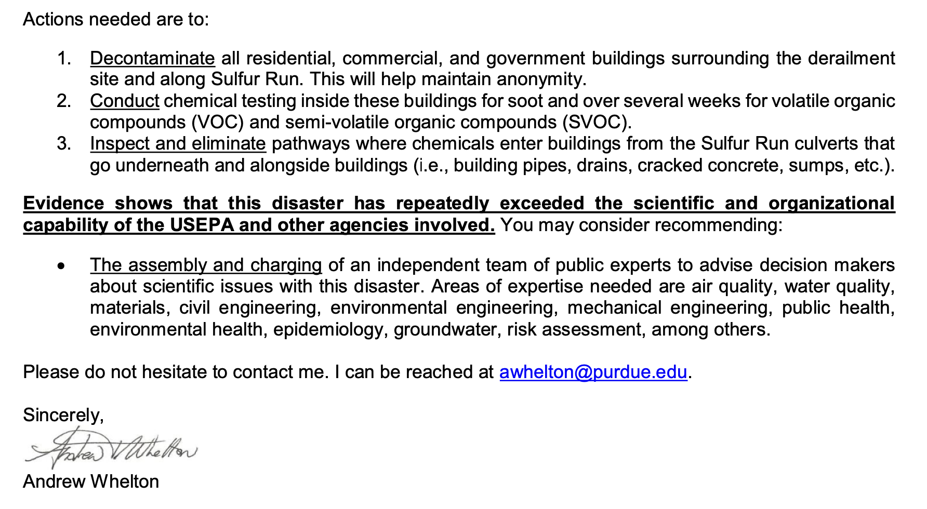
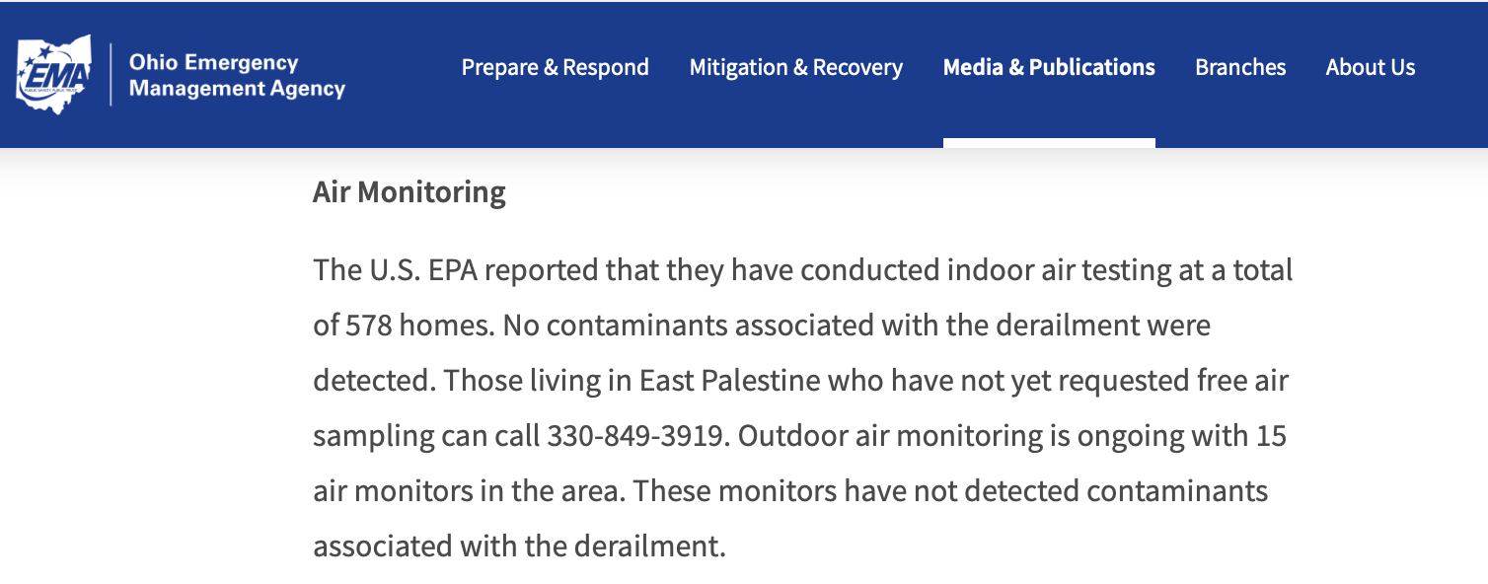
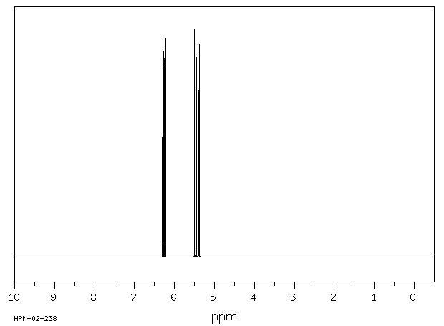
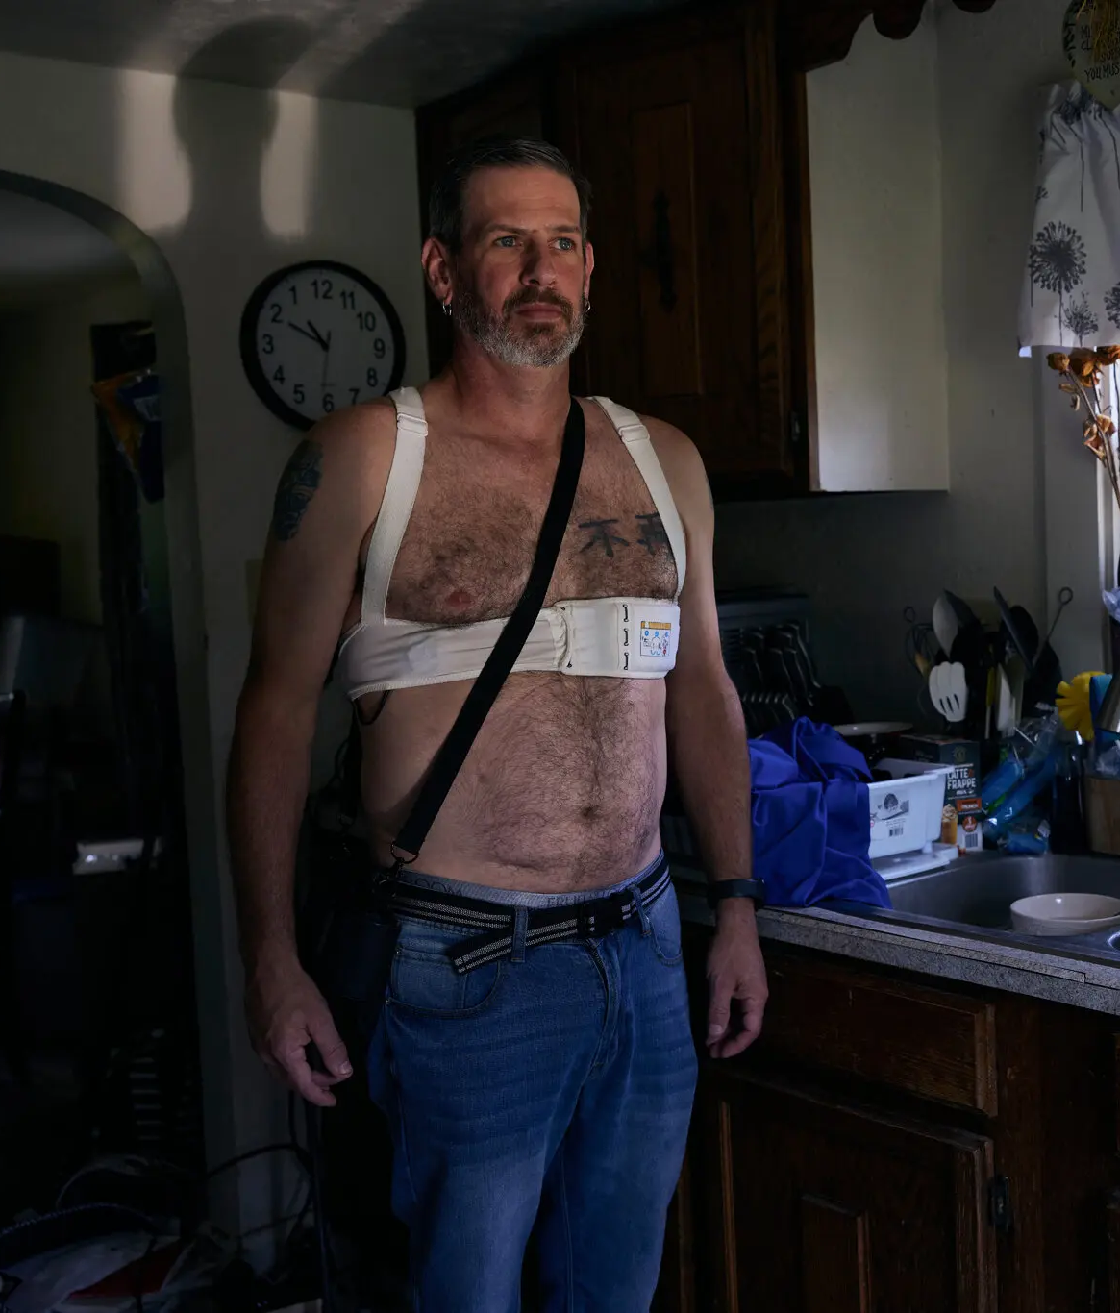
The Making of “School Chemistry”
Chemistry
1s²2s²2p⁶3s²3p⁵
Not Chemistry
Vinyl chloride Δ_{f}H^{º}(0 K) 29.56 kJ/mol
Chris Albright experienced rapid heart deterioration following the Norfolk Southern derailment in Palestine, Ohio
Baumgaertner, E. (2023). One Family’s Toxic Train Wreck Ordeal: Illness, Exile and Debt. The New York Times https://www.nytimes.com/2023/08/16/health/east-palestine-ohio-train-derailment-crisis.html?searchResultPosition=26

Slide 112
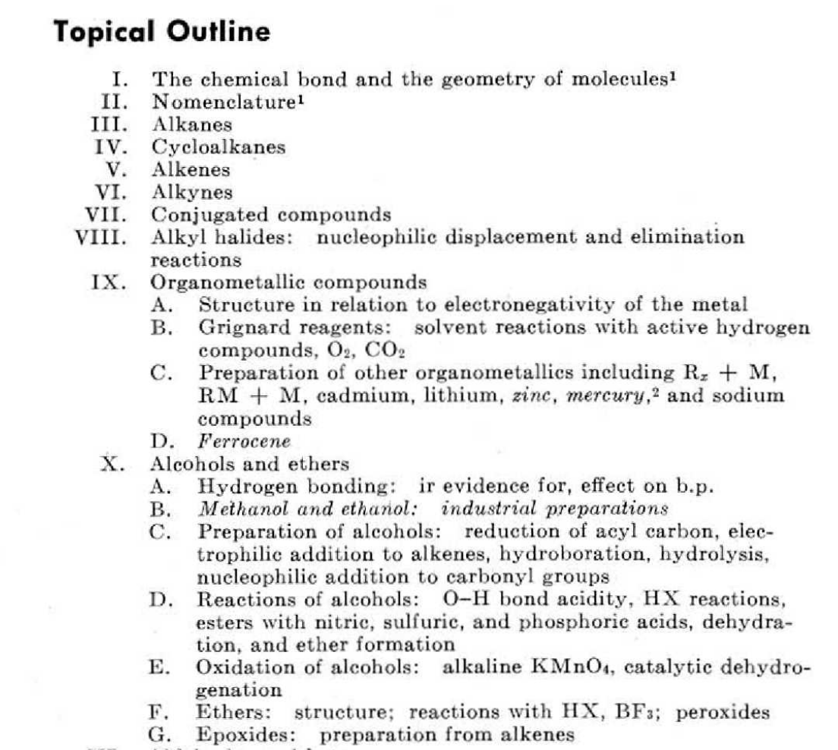
The Making of “School Chemistry”
School chemistry consists of facts and skills that seemed sensible to professional chemists in the 60s/70s
Chemistry
1s²2s²2p⁶3s²3p⁵
Vinyl chloride Δ_{f}H^{º}(0 K) 29.56 kJ/mol
Organic Subcommittee of the Curriculum Committee. (1972). Report of the Organic Subcommittee of the Curriculum Committee. Journal of Chemical Education, 49 (11), 761-763.

Slide 113
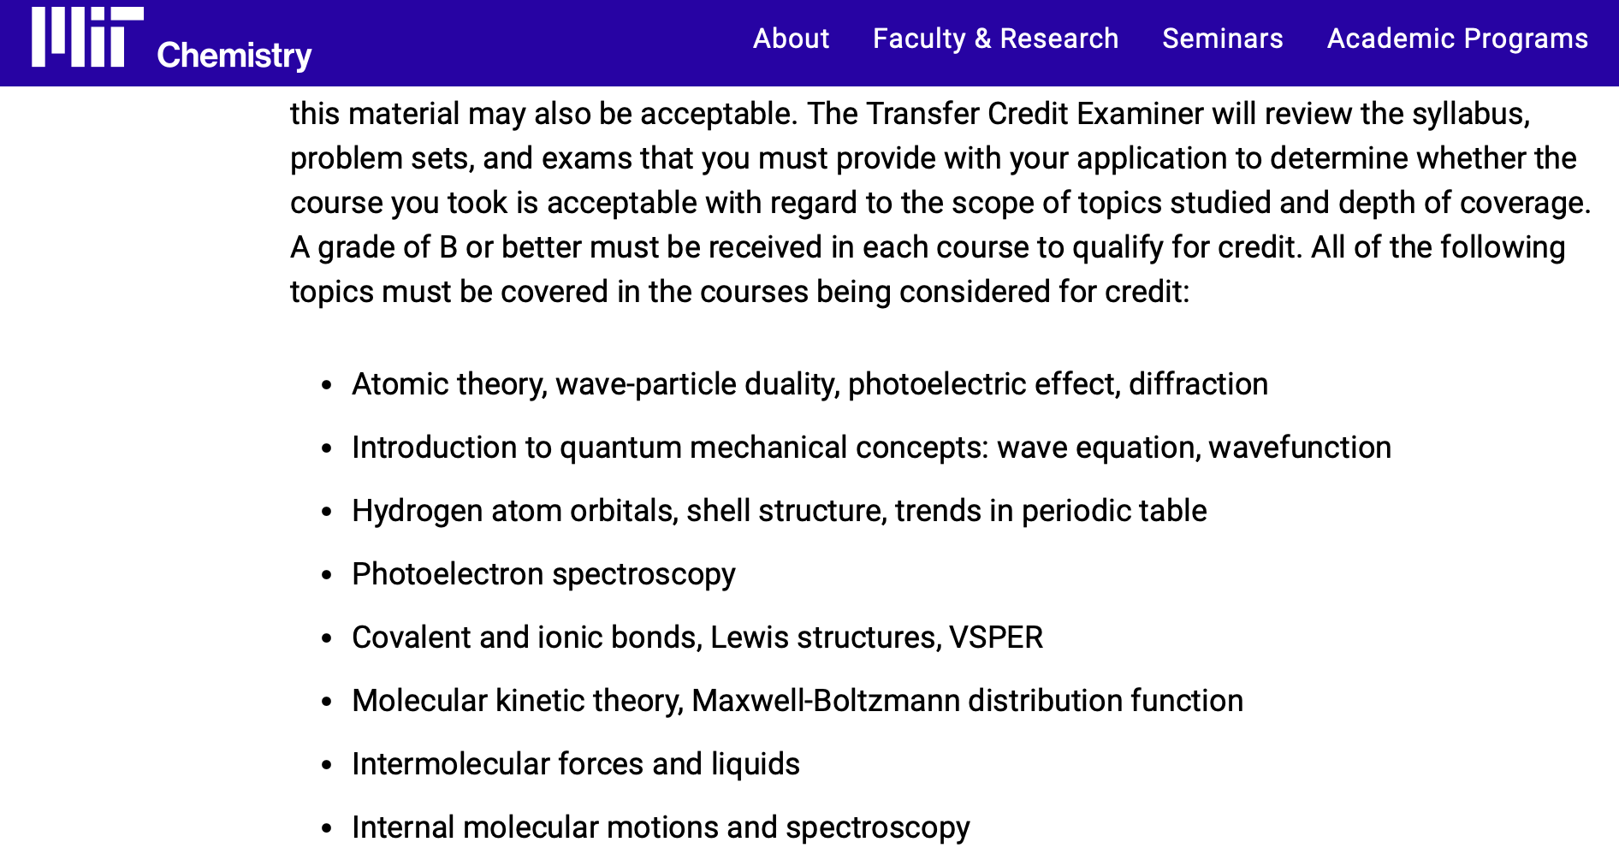


The Making of “School Chemistry”
A variety of policies and practices act to sustain the boundary between “chemistry and “not chemistry”
Chemistry
1s²2s²2p⁶3s²3p⁵
Vinyl chloride Δ_{f}H^{º}(0 K) 29.56 kJ/mol

Slide 114
Why does one need to pretend to be “a chemist” for two years to become a dentist?

Slide 115

Unsettling Our Status Quo
What assumptions were used to construct hierarchies of chemistry knowledge and how have they developed over the 20th century?
What assumptions were used to construct hierarchies of chemistry knowers and how have they developed over the 20th century?

Slide 116
Two Historical Perspectives
Hero Narratives
Chronicle stories and events from the perspective of authorities and institutions
  EX: Catherine Jackson, Oxford University
    Centers around notable figures and contributions to the world
    Paints chemists are societal benefactors with trustworthy motivations
Beretta, M. (2011). The changing role of the historiography of chemistry in continental Europe since 1800. Ambix, 58(3), 257-276.
Bensaude-Vincent, B., & Stengers, I. (1996). A history of chemistry. Harvard University Press.
Jackson, C. M. (2023). Molecular World: Making Modern Chemistry. MIT Press.
Bullock, E. C. (2019). Mathematics curriculum reform as racial remediation: A historical counterstory. In Julius Davis and Christopher C. Jett (Ed.), Critical race theory in mathematics education (pp. 75–97). New York, NY: Routledge.
Notes:
2 ways to think about history of chemistry
either its a hero narrative and things have been carefully constructed for the purpose of the good of all; or it is carefully constructed for the benefit of those in power through effective boundary work

Slide 117
Two Historical Perspectives
Hero Narratives
Chronicle stories and events from the perspective of authorities and institutions
  EX: Catherine Jackson, Oxford University
    Centers around notable figures and contributions to the world
    Paints chemists are societal benefactors with trustworthy motivations
Critical Analysis
Retells past events while questioning the norms and practices of institutions
  EX: Katie Kirchgasler, UW-Madison
    Carefully examines the impacts and motivations of institutions
Beretta, M. (2011). The changing role of the historiography of chemistry in continental Europe since 1800. Ambix, 58(3), 257-276.
Bensaude-Vincent, B., & Stengers, I. (1996). A history of chemistry. Harvard University Press.
Jackson, C. M. (2023). Molecular World: Making Modern Chemistry. MIT Press.
Bullock, E. C. (2019). Mathematics curriculum reform as racial remediation: A historical counterstory. In Julius Davis and Christopher C. Jett (Ed.), Critical race theory in mathematics education (pp. 75–97). New York, NY: Routledge.
Notes:
2 ways to think about history of chemistry
either its a hero narrative and things have been carefully constructed for the purpose of the good of all; or it is carefully constructed for the benefit of those in power through effective boundary work

Slide 118
Methodology
Historical Epistemology: critically question hero narratives; unpack naturalized practices to discover the emergence of their assumptions and how they have been reconfigured in disciplines, institutions, and throughout time
Daston, L. (1994). Historical epistemology. In J. Chandler, A. Davidson, & H. Harootunian (Eds.), Questions of evidence: Proof, practice, and persuasion across the disciplines (pp. 282–289). University of Chicago Press.
Daston, L. (Ed.). (2000). Biographies of scientific objects. University of Chicago Press.
Kirchgasler, K. L. (2023). Science class as clinic: Why histories of segregated instruction matter for health equity reforms today. Science Education, 107(1), 42–70.
Haraway, D. (1991). Simians, cyborgs, and women: The reinvention of nature. Taylor & Francis.

Slide 119
Methodology
Historical Epistemology: critically question hero narratives; unpack naturalized practices to discover the emergence of their assumptions and how they have been reconfigured in disciplines, institutions, and throughout time
Methods used include:
    Citational Backmapping: traces assumptions by connecting key sources throughout the dataset
Daston, L. (1994). Historical epistemology. In J. Chandler, A. Davidson, & H. Harootunian (Eds.), Questions of evidence: Proof, practice, and persuasion across the disciplines (pp. 282–289). University of Chicago Press.
Daston, L. (Ed.). (2000). Biographies of scientific objects. University of Chicago Press.
Kirchgasler, K. L. (2023). Science class as clinic: Why histories of segregated instruction matter for health equity reforms today. Science Education, 107(1), 42–70.
Haraway, D. (1991). Simians, cyborgs, and women: The reinvention of nature. Taylor & Francis.

Slide 120
Methodology
Historical Epistemology: critically question hero narratives; unpack naturalized practices to discover the emergence of their assumptions and how they have been reconfigured in disciplines, institutions, and throughout time
Methods used include:
    Citational Backmapping: traces assumptions by connecting key sources throughout the dataset
    Tabular Coding: comparison of assumptions to track evolution and persistence
Daston, L. (1994). Historical epistemology. In J. Chandler, A. Davidson, & H. Harootunian (Eds.), Questions of evidence: Proof, practice, and persuasion across the disciplines (pp. 282–289). University of Chicago Press.
Daston, L. (Ed.). (2000). Biographies of scientific objects. University of Chicago Press.
Kirchgasler, K. L. (2023). Science class as clinic: Why histories of segregated instruction matter for health equity reforms today. Science Education, 107(1), 42–70.
Haraway, D. (1991). Simians, cyborgs, and women: The reinvention of nature. Taylor & Francis.

Slide 121
Literature Search
Literature Search: 512 relevant articles from 1890-2024
Journals:
  Journal of Chemical Education, Journal of the American Chemical Society, and Science Education
Keywords:
  chemistry, education, college, and undergraduate

Slide 122

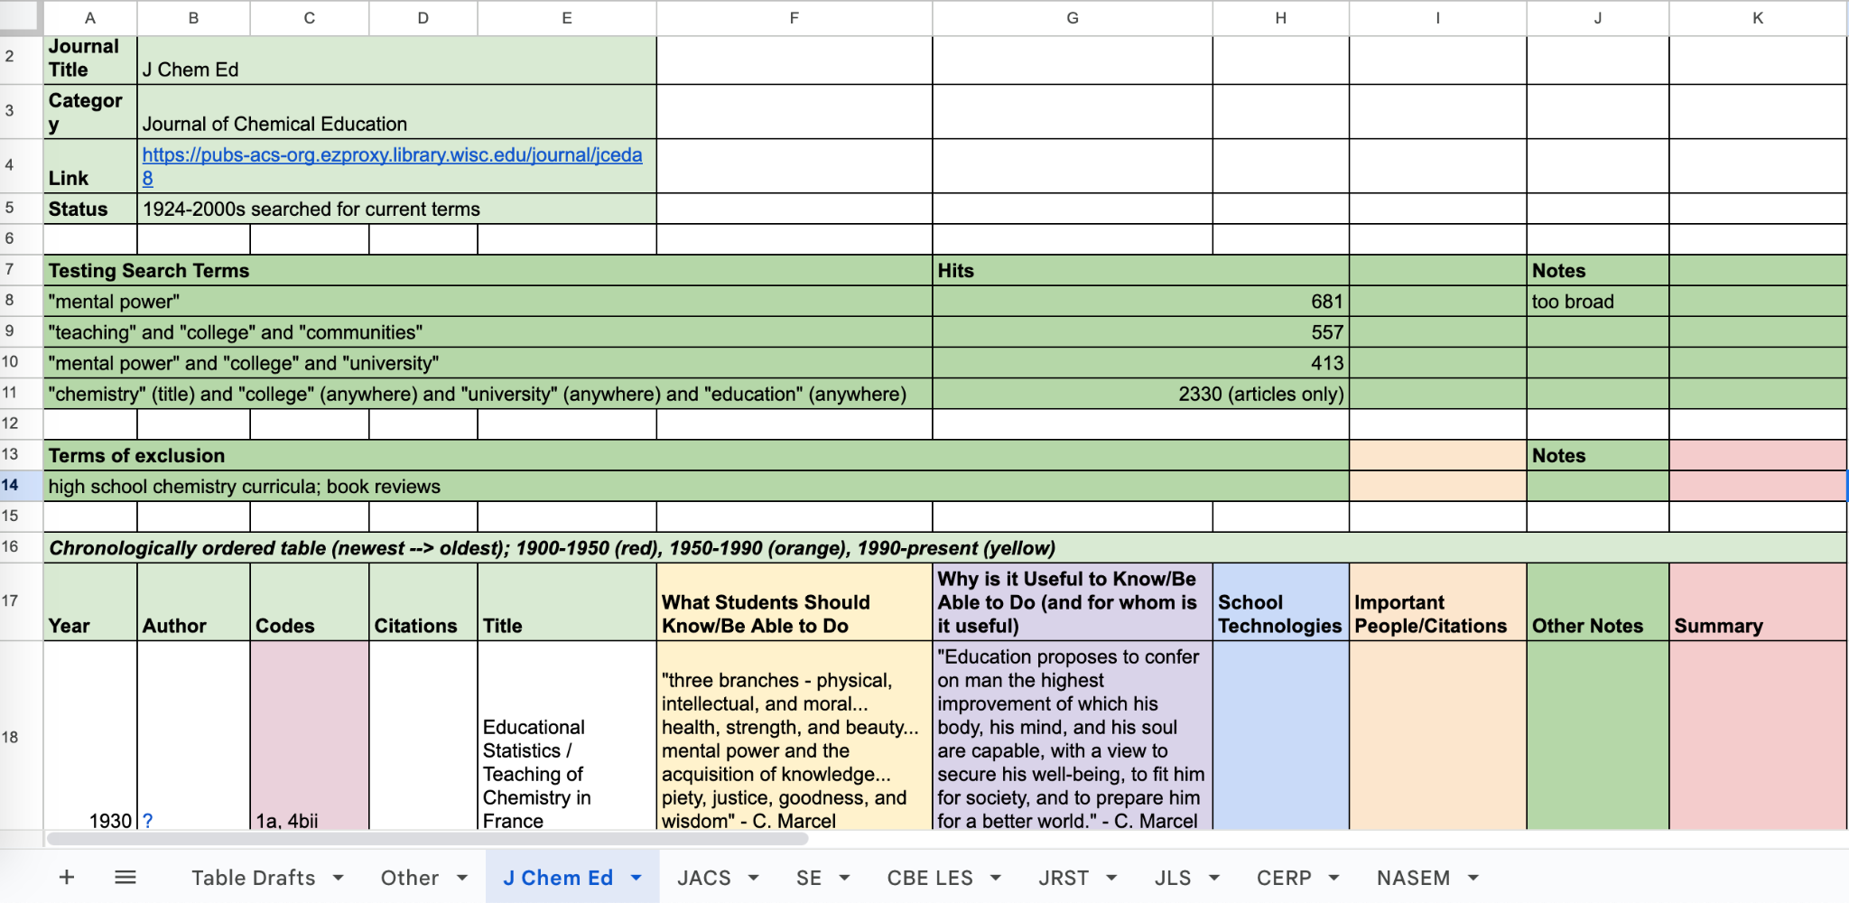
Data Collection and Reduction

Slide 123
Descriptive Coding
Codes describe types of answer to two questions
What is (or should be) the content of a college chemistry course?
Why is engaging in this content in certain ways useful?
* When describing answers to these questions, we attended to who was meant to engage with particular content and for what purpose

Slide 124
Descriptive Coding
  Course Content: pre-professional training, liberal education, principles, prerequisites, historical context, assessments

Slide 125
Descriptive Coding
  Course Content: pre-professional training, liberal education, principles, prerequisites, historical context, assessments
  Traits: morals, character, personality, mental training, cultural training, scientific attitude/spirit
  Skills: study habits, laboratory skills, instrumentation, problem-solving, use of library resources
  View of Science: public view of science, ways of knowing, utility of chemistry knowledge/skills
  National prosperity: societal benefits, economic benefits, war efforts, elitism

Slide 126
Tabular Coding & Comparative Analysis
Tabular Coding: quotes in each category were grouped by decade and compared to each other

Slide 127
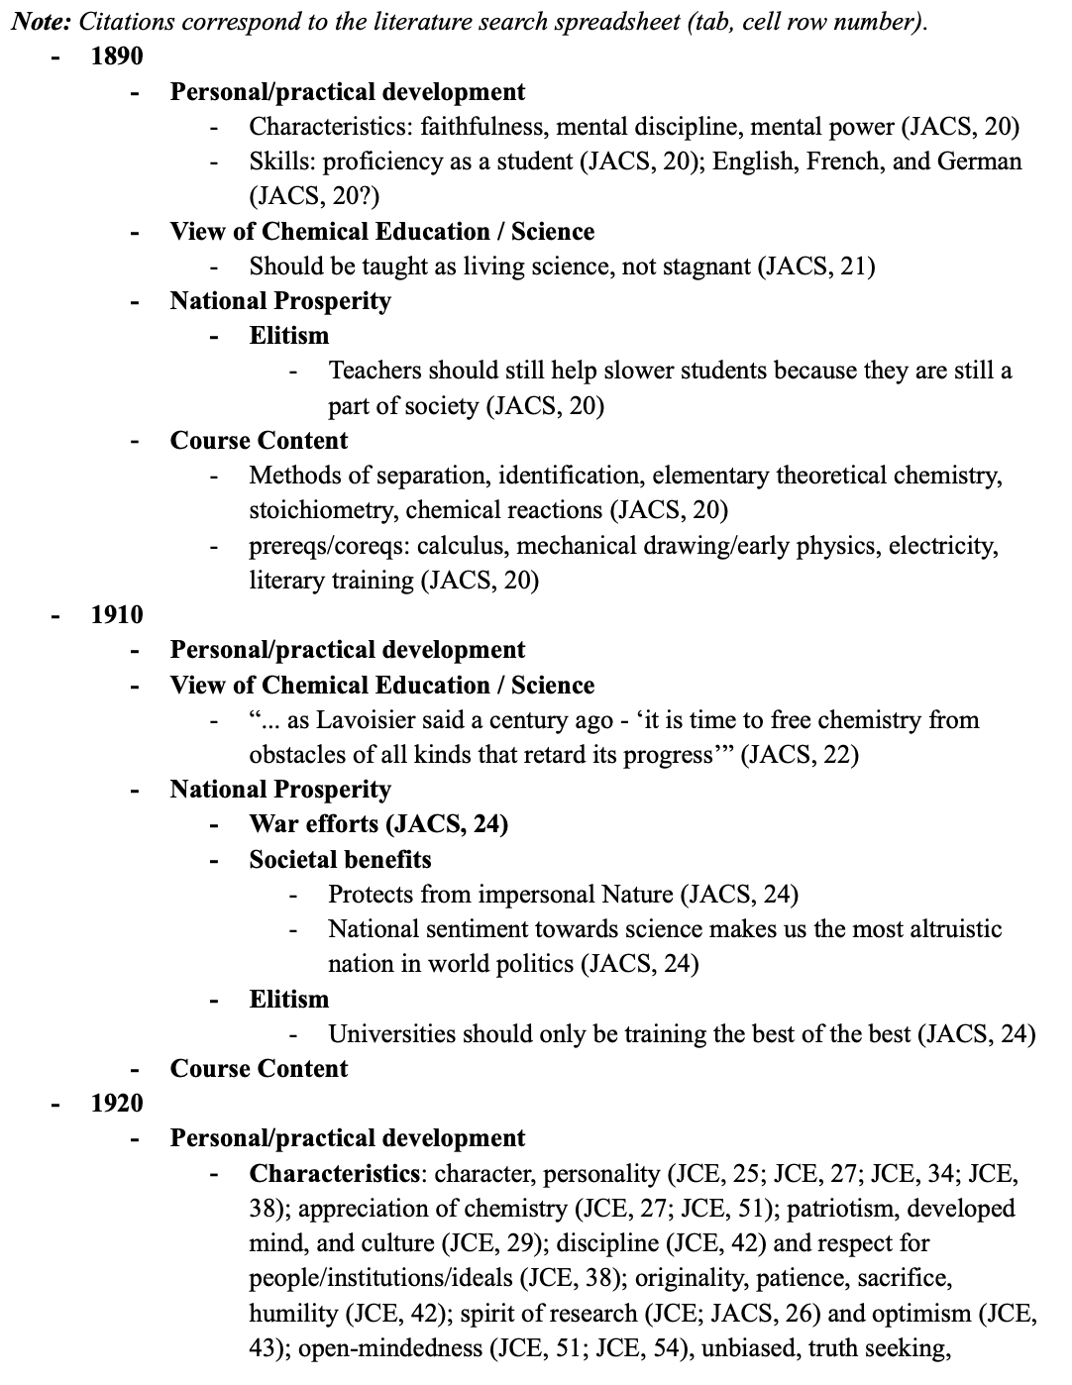
Tabular Coding & Comparative Analysis
Tabular Coding: quotes in each category were grouped by decade and compared to each other

Slide 128
Tabular Coding & Comparative Analysis
Tabular Coding: quotes in each category were grouped by decade and compared to each other
Comparative Analysis: analysis shifts, continuities, and tensions in the content, rhetoric, and language used in the articles

Slide 129
Tabular Coding & Comparative Analysis
Tabular Coding: quotes in each category were grouped by decade and compared to each other
Comparative Analysis: analysis shifts, continuities, and tensions in the content, rhetoric, and language used in the articles
We looked for shifts before and after the introduction of “broadening participation” reforms in the 1970s.

Slide 130
Findings
Epistemic premises that justify hierarchies of chemistry knowledge and knowers

Slide 131
Future Experts need Abstract Rigor
Possible Future Experts
Notes:
RLS end

Slide 132
Future Experts need Abstract Rigor
Possible Future Experts
Abstract
Chemistry
Notes:
RLS end

Slide 133
Future Experts need Abstract Rigor
Possible Future Experts
Abstract
Chemistry
Worthy Intellectual Elite
Students of Low Ability
Notes:
RLS end

Slide 134
Future Experts need Abstract Rigor
Possible Future Experts
Abstract
Chemistry
Worthy Intellectual Elite
Students of Low Ability
1920s–60s (Pre-Broadening Participation)
Exacting rigor of abstract chemistry needed to sort out future specialists and stimulate their advancement within a selective, competitive system to preserve national progress
“Vigorous discipline also teaches the great virtues of patience and sacrifice… Frequently people with a little talent can gain high honors in an English course, with little or no studying, but in chemistry, although talent lightens the burden a little, even the best student must study hard and regularly.” (Baker, 1927)
Baker, D. (1926). Chemistry as an instrument of general education. Journal of Chemical Education, 4(9), 1120-1125.
Notes:
RLS end

Slide 135
Future Experts need Abstract Rigor
Possible Future Experts
Abstract
Chemistry
Worthy Intellectual Elite
Students of Low Ability
1920s–60s (Pre-Broadening Participation)
Exacting rigor of abstract chemistry needed to sort out future specialists and stimulate their advancement within a selective, competitive system to preserve national progress
“Schools have been a potent factor in the development of an intellectual elite, the class responsible for the progress of civilization in any country… The formation of an intellectually superior class should be the dominant preoccupation of any country that expects to cut a figure in world affairs… It is a very noble task to aid in the creation of an intellectual aristocracy.” (Graffin, 1929)
Grafflin, M.W. (1929). The formation of the elite. Journal of Chemical Education, 6(3), 565-571.
Notes:
These quotes explicitly show intentionality. We aren’t inferring this – they say the thing. These techniques didn’t just happen. However, these intentions are not (necessarily) adopted by all those who use the school technologies. Intentionally discriminating between folks who are already closer to the “ideal” and those who are “not”. Graffin’s intentionality is still acting through the techniques of the course – you would need to use different techniques in order to not propagate Grafflin’s hierarchy-making goals. The “you” who has to change is at a very high level in chemistry education.

Slide 136
Future Experts need Abstract Rigor
Possible Future Experts
Abstract
Chemistry
Worthy Intellectual Elite
Students of Low Ability
1920s–60s (Pre-Broadening Participation)
Exacting rigor of abstract chemistry needed to sort out future specialists and stimulate their advancement within a selective, competitive system to preserve national progress
Use of IQ, scientific aptitude, and placement tests to parse who may enter, and time-pressure course tests graded on a curve to determine who may persist
Notes:
RLS end

Slide 137
Future Experts need Abstract Rigor
Possible Future Experts
Abstract
Chemistry
Worthy Intellectual Elite
Students of Low Ability
1920s–60s (Pre-Broadening Participation)
Exacting rigor of abstract chemistry needed to sort out future specialists and stimulate their advancement within a selective, competitive system to preserve national progress
Use of IQ, scientific aptitude, and placement tests to parse who may enter, and time-pressure course tests graded on a curve to determine who may persist E.g., chemistry placement tests, calibrated to display premise of innate differences in aptitude along bell curve, aim to salvage superior students and prevent the entry of those deemed destined to fail based on natural aptitude (Cornog & Stoddard, 1925; Kirk, 1932)
Notes:
RLS end

Slide 138
Future Experts need Abstract Rigor
Possible Future Experts
Abstract
Chemistry
Worthy Intellectual Elite
Students of Low Ability
1920s–60s (Pre-Broadening Participation)
Exacting rigor of abstract chemistry needed to sort out future specialists and stimulate their advancement within a selective, competitive system to preserve national progress
Use of IQ, scientific aptitude, and placement tests to parse who may enter, and time-pressure course tests graded on a curve to determine who may persist E.g., chemistry placement tests, calibrated to display premise of innate differences in aptitude along bell curve, aim to salvage superior students and prevent the entry of those deemed destined to fail based on natural aptitude (Cornog & Stoddard, 1925; Kirk, 1932) E.g., persistence of mental discipline theory (though already disproven) that drilling in arduous memorization tasks stimulates superior mental and moral development (Fry, 1925; see critique in Rich, 1925)
Notes:
RLS end

Slide 139
Future Experts need Abstract Rigor
Possible Future Experts
Abstract
Chemistry
Worthy Intellectual Elite
Students of Low Ability
1970s – 2020s (Broadening Participation)
Exacting rigor of abstract chemistry needed to sort out future specialists and stimulate their advancement within a selective, competitive system to preserve national progress
“What is needed primarily is a change in attitude so that the student puts aside his ‘high-school culture’ and becomes gradually more civilized and scholarly - which means that he develops an increasing degree of self-discipline…” (Cassidy, 1971)
Cassidy, H.G. (1971). Let us dream… Journal of Chemical Education, 48(12), 801-804.
Notes:
RLS end

Slide 140
Future Experts need Abstract Rigor
Possible Future Experts
Abstract
Chemistry
Worthy Intellectual Elite
Students of Low Ability
1970s – 2020s (Broadening Participation)
Exacting rigor of abstract chemistry needed to sort out future specialists and stimulate their advancement within a selective, competitive system to preserve national progress
“Since mastery of certain concepts in the sciences, especially chemistry and physics, requires abstract reasoning, a number of investigators have concluded that poor performance of many chemistry students is due to the fact that they have not achieved Piaget’s stage of formal operations” (Milakofsky & Patterson, 1979)
Milakofsky, L., & Patterson, H.O. (1979). Chemical education and Piaget: A new paper-pencil inventory to assess cognitive functioning. Journal of Chemical Education, 56(2), 87-90.
Notes:
RLS end

Slide 141
Future Experts need Abstract Rigor
Possible Future Experts
Abstract
Chemistry
Worthy Intellectual Elite
Students of Low Ability
1970s – 2020s (Broadening Participation)
Exacting rigor of abstract chemistry needed to sort out future specialists and stimulate their advancement within a selective, competitive system to preserve national progress
Persistent use of placement tests to parse who may enter, and time-pressure course tests graded on a curve to determine who may persist, now coupled with compensatory reforms (content remediation, psychosocial interventions) to broaden participation
Notes:
RLS end

Slide 142
Future Experts need Abstract Rigor
Possible Future Experts
Abstract
Chemistry
Worthy Intellectual Elite
Students of Low Ability
1970s – 2020s (Broadening Participation)
Exacting rigor of abstract chemistry needed to sort out future specialists and stimulate their advancement within a selective, competitive system to preserve national progress
Persistent use of placement tests to parse who may enter, and time-pressure course tests graded on a curve to determine who may persist, now coupled with compensatory reforms (content remediation, psychosocial interventions) to broaden participation E.g., Piagetian tests, calibrated in ways that displayed racial hierarchies in cognitive development (Chiappetta, 1976), claim to avoid disadvantaging ‘culturally deprived’ groups by using pictorial tests to sort concrete/abstract thinkers and non/science students (Milakofsky & Patterson, 1979)
Notes:
RLS end

Slide 143
Future Experts need Abstract Rigor
Possible Future Experts
Abstract
Chemistry
Worthy Intellectual Elite
Students of Low Ability
1970s – 2020s (Broadening Participation)
Exacting rigor of abstract chemistry needed to sort out future specialists and stimulate their advancement within a selective, competitive system to preserve national progress
Persistent use of placement tests to parse who may enter, and time-pressure course tests graded on a curve to determine who may persist, now coupled with compensatory reforms (content remediation, psychosocial interventions) to broaden participation E.g., Piagetian tests, calibrated in ways that displayed racial hierarchies in cognitive development (Chiappetta, 1976), claim to avoid disadvantaging ‘culturally deprived’ groups by using pictorial tests to sort concrete/abstract thinkers and non/science students (Milakofsky & Patterson, 1979) E.g., persistent statements that the exacting rigor of introductory courses improves discipline in thinking (Finnerty et al., 2010), while instruments of grit, mindset, and self-efficacy permit claims that intersectional disparities reflect individual needs for psychosocial development (see critiques in Ryu et al., 2021, Vincent-Ruz et al., 2024)
Notes:
RLS end

Slide 144
Future Citizens need Applied Relevance
Possible Future Experts
Abstract
Chemistry
Worthy Intellectual Elite
Students of Low Ability
Future Citizens
Notes:
RLS end

Slide 145
Future Citizens need Applied Relevance
Possible Future Experts
Abstract
Chemistry
Worthy Intellectual Elite
Students of Low Ability
Future Citizens
Applied, Relevant Chemistry
Notes:
RLS end

Slide 146
Future Citizens need Applied Relevance
Possible Future Experts
Abstract
Chemistry
Worthy Intellectual Elite
Students of Low Ability
Future Citizens
Applied, Relevant Chemistry
Citizens with a baseline of reason that appreciate science
Notes:
RLS end

Slide 147
Future Citizens need Applied Relevance
1920s–60s (Pre-Broadening Participation)
Contextual relevance of applied chemistry needed to secure a baseline of reason in nonspecialist citizens and ensure their appreciation of science as a cultural achievement
“In order to develop an interest in his job [e.g., candy-maker, janitor, painter], the worker should be given some information about the sources of the raw material, the changes that material undergoes during the process of manufacture and what becomes of the final product.” (Schwarz, 1927)
Schwarz, A. (1927). Chemistry as material in vocational adjustment. Journal of Chemical Education, 4(8), 973-975.
Future Citizens
Applied, Relevant Chemistry
Citizens with a baseline of reason that appreciate science
Notes:
RLS end

Slide 148
Future Citizens need Applied Relevance
1920s–60s (Pre-Broadening Participation)
Contextual relevance of applied chemistry needed to secure a baseline of reason in nonspecialist citizens and ensure their appreciation of science as a cultural achievement
“The training in fundamentals, mathematics, for example, is becoming less and less. This general factor makes it more difficult for the mediocre student to satisfy the high standards set by the science faculties. Economic conditions now make it necessary to salvage these students if possible… If they are taught by the demonstration method they can at least see science in action. The cultural value of science will be emphasized.” (Elder, 1936)
Elder, A.L. (1936). Applicability of the lecture demonstration to certain groups of students. Journal of Chemical Education, 13(2), 65-68.
Future Citizens
Applied, Relevant Chemistry
Citizens with a baseline of reason that appreciate science
Notes:
RLS end

Slide 149
Future Citizens need Applied Relevance
1920s–60s (Pre-Broadening Participation)
Contextual relevance of applied chemistry needed to secure a baseline of reason in nonspecialist citizens and ensure their appreciation of science as a cultural achievement
Design of cultural or non-majors courses to help nonscientists live rationally and morally in a scientific age (Sampey, 1928; Tead, 1952), while protecting superior students from the ‘stampede’ of weaker ones (Hopkins, 1935)
Future Citizens
Applied, Relevant Chemistry
Citizens with a baseline of reason that appreciate science
Notes:
RLS end

Slide 150
Future Citizens need Applied Relevance
1920s–60s (Pre-Broadening Participation)
Contextual relevance of applied chemistry needed to secure a baseline of reason in nonspecialist citizens and ensure their appreciation of science as a cultural achievement
Design of cultural or non-majors courses to help nonscientists live rationally and morally in a scientific age (Sampey, 1928; Tead, 1952), while protecting superior students from the ‘stampede’ of weaker ones (Hopkins, 1935) E.g., recapitulation theory that adapted chemistry instruction can raise the mental development of each pupil by repeating civilizational stages of racial evolution: from ‘savagery’ to medieval alchemy to great minds of modern chemists (Davis, 1932; Reinmuth, 1928)
Future Citizens
Applied, Relevant Chemistry
Citizens with a baseline of reason that appreciate science
Notes:
RLS end

Slide 151
Future Citizens need Applied Relevance
1920s–60s (Pre-Broadening Participation)
Contextual relevance of applied chemistry needed to secure a baseline of reason in nonspecialist citizens and ensure their appreciation of science as a cultural achievement
Design of cultural or non-majors courses to help nonscientists live rationally and morally in a scientific age (Sampey, 1928; Tead, 1952), while protecting superior students from the ‘stampede’ of weaker ones (Hopkins, 1935) E.g., recapitulation theory that adapted chemistry instruction can raise the mental development of each pupil by repeating civilizational stages of racial evolution: from ‘savagery’ to medieval alchemy to great minds of modern chemists (Davis, 1932; Reinmuth, 1928) E.g., vocational adjustment theory that chemistry applications can be adapted to free the minds of the masses, making more efficient, enthusiastic laborers (e.g., janitor, laundry-worker) (Schwartz, 1927)
Future Citizens
Applied, Relevant Chemistry
Citizens with a baseline of reason that appreciate science
Notes:
RLS end

Slide 152
Future Citizens need Applied Relevance
1970s – 2020s (Broadening Participation)
Contextual relevance of applied chemistry needed to secure a baseline of reason in nonspecialist citizens and ensure their appreciation of science as a cultural achievement
“The reason for being concerned about teaching science to our increasing crop of scientifically illiterate students is of course partly based on the threats to science that may be posed by this body of ill-educated citizens with votes, especially under the influence of demagogs; of obscene clowns with their minstrels and camp-following drug-pushers; or of well-meaning scientists who are themselves illiterate, and easily misled by logical reasoning from cultural premises that are dubious…” (Cassidy, 1971)
Cassidy, H.G. (1971). Let us dream… Journal of Chemical Education, 48(12), 801-804.
Future Citizens
Applied, Relevant Chemistry
Citizens with a baseline of reason that appreciate science
Notes:
RLS end

Slide 153
Future Citizens need Applied Relevance
1970s – 2020s (Broadening Participation)
Contextual relevance of applied chemistry needed to secure a baseline of reason in nonspecialist citizens and ensure their appreciation of science as a cultural achievement
Continual design of separate non-majors courses to help nonscientists appreciate values of chemistry for individual and national development (Hostettler, 1979) and attain basic science literacy via more expansive contextualization, while protecting majors courses to focus on content to advance frontiers (El Sayed, 1987)
Future Citizens
Applied, Relevant Chemistry
Citizens with a baseline of reason that appreciate science
Notes:
RLS end

Slide 154
Future Citizens need Applied Relevance
1970s – 2020s (Broadening Participation)
Contextual relevance of applied chemistry needed to secure a baseline of reason in nonspecialist citizens and ensure their appreciation of science as a cultural achievement
Continual design of separate non-majors courses to help nonscientists appreciate values of chemistry for individual and national development (Hostettler, 1979) and attain basic science literacy via more expansive contextualization, while protecting majors courses to focus on content to advance frontiers (El Sayed, 1987) E.g., sociological theories ascribe student unrest to permissive attitudes and seek to instill personal discipline in ‘scientific illiterates’ by raising their appreciation for scientists as world cultural leaders (Cassidy, 1971)
Future Citizens
Applied, Relevant Chemistry
Citizens with a baseline of reason that appreciate science
Notes:
RLS end

Slide 155
Future Citizens need Applied Relevance
1970s – 2020s (Broadening Participation)
Contextual relevance of applied chemistry needed to secure a baseline of reason in nonspecialist citizens and ensure their appreciation of science as a cultural achievement
Continual design of separate non-majors courses to help nonscientists appreciate values of chemistry for individual and national development (Hostettler, 1979) and attain basic science literacy via more expansive contextualization, while protecting majors courses to focus on content to advance frontiers (El Sayed, 1987) E.g., sociological theories ascribe student unrest to permissive attitudes and seek to instill personal discipline in ‘scientific illiterates’ by raising their appreciation for scientists as world cultural leaders (Cassidy, 1971) E.g., identity development theories suggest diversifying content in chemistry for non-majors courses as an ideal mode to broaden understanding of science among lay people, especially of marginalized identities, and ideally as a first step to diversifying the content majors courses as well (Livezey, 2022)
Future Citizens
Applied, Relevant Chemistry
Citizens with a baseline of reason that appreciate science
Notes:
RLS end

Slide 156
Unsettling Our Status Quo
The two epistemic premises we have surfaced constrain conceivable approaches to reform
Rejecting these and related premises could allow us to more expansively imagine just and useful chemistry learning

Slide 157
Centering Utility in Daily Life
Chemistry

Slide 158

Centering Utility in Daily Life
Chemistry
Baumgaertner, E. (2023). One Family’s Toxic Train Wreck Ordeal: Illness, Exile and Debt. The New York Times https://www.nytimes.com/2023/08/16/health/east-palestine-ohio-train-derailment-crisis.html?searchResultPosition=26
Notes:
Rachelle Burkes. Designing chemical testing strip that lets community members produce knowledge that they can use to legitimize their lived experiences to folks with regulatory power.

Slide 159
References
Cassidy, H. G. (1971). Physical science for the nonscientist and the antiscientist. Journal of Chemical Education, 48(4), 212–215.
Chiappetta, E. L. (1976). A review of Piagetian studies relevant to science instruction at the secondary and college level. Science Education, 60(2), 253–261.
Cornog, J., & Stoddard, G.D. (1925). Predicting performance in chemistry. Journal of Chemical Education. 2(8), 701–708.
Davis, W. (1932). Writing popular chemistry. Journal of Chemical Education, 9(11), 1874–1875.
El Sayed, M. (1987). Opportunities in chemistry: The Pimentel report. Journal of Chemical Education, 64(2), 98–99.
Fry, H. S. (1925). Questions relative to the correlation of college and high-school chemistry courses. Journal of Chemical Education, 2(4), 260–269.
Hopkins, B. S. (1935). The cultural value of chemistry in general education. Journal of Chemical Education, 12(9), 418–422.
Hostettler, J. D. (1979). A decade of chemistry for nonscientists–1968 to 1977. Journal of Chemical Education, 56(1), 33–34.
Kirk, R. E. (1932). Research for the undergraduate. Journal of Chemical Education, 9(2), 280-284.
Livezey, M. R. (2021). Using diverse, equitable, and inclusive course content to improve outcomes in a chemistry course for nonmajors. Journal of Chemical Education, 99(1), 346–352.
Milakofsky, L., & Patterson, H. O. (1979). Chemical education and Piaget: A new paper-pencil inventory to assess cognitive functioning. Journal of Chemical Education, 56(2), 87–90.
Reinmuth, O. (1928). Why study chemistry? Journal of Chemical Education, 5(9), 1148–1152.
Rich, S. G. (1925). Some misconceptions of chemical education. Journal of Chemical Education, 2(2), 98–158.
Ryu, M., Bano, R., & Wu, Q. (2021). Where does CER stand on diversity, equity, and inclusion? Insights from a literature review. Journal of Chemical Education, 98(12), 3621–3632.
Sampey, J. R. (1928). An outline of pandemic chemistry. Journal of Chemical Education, 5(10), 1243–1249.
Schwartz, A. (1927). Chemistry as material in vocational adjustment. Journal of Chemical Education, 4(8), 973–975.
Tead, O. (1952). Effective learning in college. Journal of Chemical Education, 29(11), 533–588.
Vincent-Ruz, P., Izykowicz, M. M., & Rojas, A. J. (2024). A counterstory to deficit narratives of “underperformance” of demographically minoritized students in general chemistry. Journal of Chemical Education, 101(6), 2188–2202.
Notes:
RLS end

Slide 160
Questions?
rstowe@chem.wisc.edu
stowe.chem.wisc.edu

